Slide 1
Digital and IT Professional Services 2
(DIPS 2)
RM6413
Supplier Surgery
5th August 2026

Slide 2
Housekeeping
This is a pre-market engagement and GCA makes no commitment to the procurement of DIPS 2
Everything discussed in this engagement is subject to change
Treat this as an open and collaborative environment
We will use Menti to gather feedback and engage
Notes:
Liam

Slide 3
Agenda
TechUK Housekeeping
Welcome and introductions
Indicative procurement timeline
Recap of previous engagement
DIPS 2 call-off mechanisms
DIPS 2 high level ITT design
Neutral vendor lot overview
Next steps and closing remarks
Notes:
Liam

Slide 4
Indicative procurement timeline

Slide 5




Procurement timeline
We are here
01
02
03
04
Feb 26 - Dec 26
Dec 26 - Mar 27
March 2027
September 2027
Pre-market engagement
ITT preparation
ITT launch
Go live
Notes:
Liam

Slide 6
Recap of previous engagement

Slide 7
DIPS 2
Overview
Area | Proposal
Commercial vehicle | Defence and Security framework, which provides for the future award of public contracts that are defence and security contracts 4+1+1 year term £2.8bn FTS inc VAT
Scope | IT and digital professional services across full services lifecycle design, transition, deployment, testing, management, exit Includes programme and project management provisions Includes consultancy services, end user services, application services, cloud services, infrastructure services, networks, cyber and security services, RUN services, specialist and emerging technology services Ability to provide services across all security classifications and to deploy SC, DV, sole UK nationals Transition to conflict enablement
Framework structure | Defence and security standard framework Lotting structure aligned to MoD requirements and enabling speed to market
Call-off mechanisms | No minimum or maximum term for call offs and flexibility to choose appropriate extension Incorporation of competitive flexible procedure into further competition allowing POC, POV, discovery, negotiation, presentations etc to be used as part of a call off mechanism Competitive selection procedure, AWOC, rapid call off, downselection
Terms and conditions | Possibility to use a ‘Defence Call Off Schedule’ Consideration given to flexibility in selecting appropriate terms Statements of Work
KEY OBJECTIVES
adopts competition by default
effectively uses co-creation
contracts for outcomes by default
supports a transition to conflict scenario
a one stop shop for Defence’s digital and IT professional services needs
Notes:
Darren

Slide 8
Draft DIPS 2 Scope
Requirements in scope:
Digital Delivery
Software Engineering & Application Development
Data, AI, and Analytics
Information and Knowledge Management
Cyber Security & Information Assurance
Cloud, Infrastructure & Network Services
Technical Assurance & Architecture Services
Project, Programme and Portfolio Management
IT Service Management & Operational Support
Business Analysis, Transformation and Change Services
The following are excluded from DIPS 2 scope:
contingent labour (including resource augmentation),
hardware or software procurement.
Notes:
Darren

Slide 9
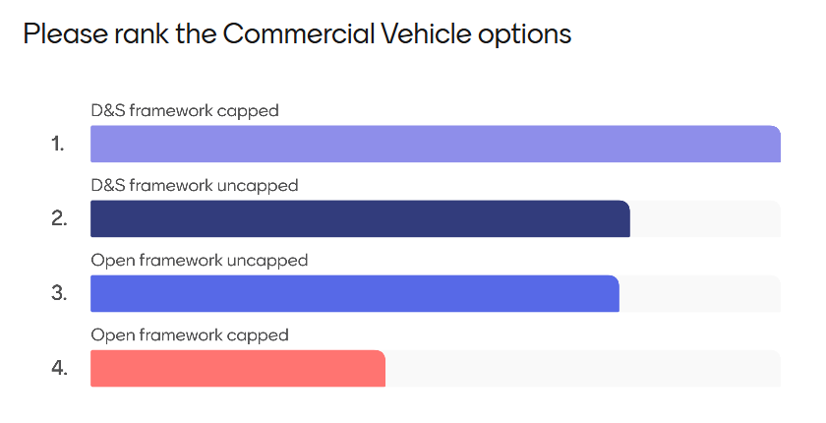
Commercial vehicle options - market feedback
Notes:
Liam

Slide 10
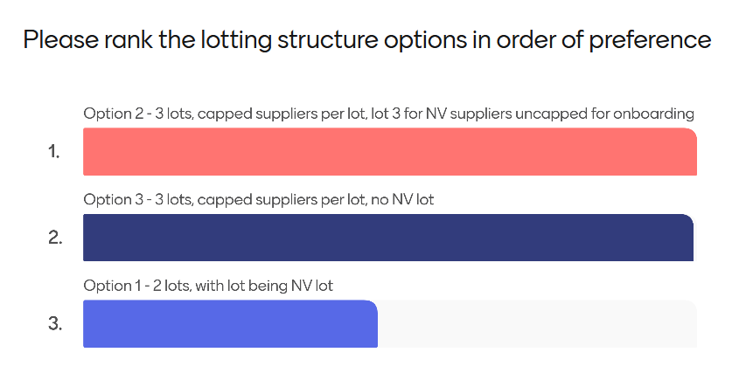
Lotting structure design options - market feedback
Notes:
Liam

Slide 11
DIPS 2 structure
Standard framework up to 4 years
4 years with no extensions
Lot restrictions resulting in 17 suppliers across all lots
6 lots
DIPS 1
Framework type
Term
Supplier numbers
Framework structure
Defence and security framework
Up to 8 years
No minimum or maximum call off term
4+1+1
Lot level restrictions
Lot 1: 10
Lot 2: 30
3 lots
DIPS 2
Notes:
Mick

Slide 12
DIPS 2 proposed call off mechanisms overview
Notes:
Mick

Slide 13
Call off mechanisms - Overview
Competitive selection process
AWOC
Downselection
Rapid call off
Competitive
selection process including:
Single stage
Two stage
Multi stage
AWOC available on all lots
Enabled through application of multi stage competitive flexible process.
Available on all lots, supporting transition to conflict
Notes:
Mick

Slide 14
Competitive selection process overview
Two stage
Multi stage
Initial Stage - Mandatory
Invite requests to participate
Determine if any suppliers are excluded or excludable
Optional Stages
Conditions of participation
Tendering
Presentation/Demonstration
Site Visit
Dialogue
Negotiation
Final Tendering Stage -
Mandatory
Apply award criteria
Single stage
Stage 1
Invite requests to participate
Apply conditions of participation, if applicable
Determine if any suppliers are excluded or excludable
Stage 2
Invite tenders
Apply award criteria
Buyers will invite tenders
Determine if any suppliers are excluded or excludable
Apply conditions of participation, if applicable
Apply award criteria
Notes:
Darren

Slide 15
DIPS 2 high level ITT design
Please remember that the information provided in these slides are for information purposes only and any information contained within these slides will be superseded by the published bid pack.
Notes:
Darren

Slide 16
Lotting structure considerations
DIPS 2 | Lot 1 Above £20m | Lot 2 £5m - £20m | Lot 3 Neutral Vendor Below £5m
No of suppliers (capped) | 10 | 30 | Uncapped for onboarding
Call off mechanism | Competitive selection process AWOC Rapid call off Downselection
Recommended max total contract value | N/A | £20m | £5m
Recommended min total contract value | £20m | £5m | No min
Max call off term | No max | No max | Recommended max 3 years
Evaluation approach | Gold FVRA | Silver FVRA | Gold FVRA (The NV)
 | High barrier to entry | Medium barrier to entry | Low barrier to entry
*This is a draft and therefore GCA reserves the right to change the lotting structure
Notes:
Darren

Slide 17
High level ITT process overview
01
02
03
ITT structure
ITT timeline
ITT stages
Competitive flexible procedure
Multi stage
Potential negotiation and / or dialogue stages for neutral vendor lot
Lot 1 and 2 will follow the standard approach 6 month timeline
Potential longer timescale to be considered for the neutral vendor lot
Lot 1 and 2
Stage 1 CoP
Stage 2
Neutral vendor lot
Stage 1 CoP
Stage 2
Stage 3
Stage 4
04
05
Lot 1 and 2 compliance
Neutral Vendor lot compliance
Stage 1: FVRA, TAC, EL Insurance, Prompt Payment, CDP + PSQ
Stage 2: Quality assessment, certification, Cyber Essentials, Price assessment, (Carbon reduction plan) CRP, Modern Slavery, Social Value
Stage 1: FVRA, TAC, EL Insurance, Prompt Payment, CDP + PSQ, Modern Slavery, CRP
Stage 2: Quality assessment, certification, Cyber Essentials, Price assessment,
Notes:
Mick

Slide 18
Technical Ability Certificates*
Suppliers won’t be restricted to providing services included in TACs
DIPS 2 | Minimum number of service lines | Minimum Contract Value | Number of TACs permitted | Work conducted within the last 'X' Years | Cumulative value applied?
Lot 1 | 9/10 | £20m | 3 | 3 | No, if more than one TAC is provided, all TACs need to evidence the minimum contract value required per lot
Lot 2 | 5/10 | £5m | 2 | 5
DIPS 2 | Minimum technical requirements | Minimum Contract Value | Minimum number of call offs /SoWs per annum | Number of TACs permitted | Work conducted within the last 'X' Years | Cumulative value applied?
Lot 3 Neutral Vendor | TBC | £5m | TBC | 2 | 3 | No, if more than one TAC is provided, all TACs need to evidence the minimum contract value required per lot
*This is a draft and therefore GCA reserves the right to change the TACs
Notes:
Darren

Slide 19
Neutral vendor overview
Notes:
Darren

Slide 20


MoD requirement overview - neutral vendor
01
100% supplier neutrality
01
Technology forms part of business offering (now or in the future)
02
End to end auditability
03
Easy to use and accessible digital tools
No digital platform / inflexible platform offering
02
04
Demonstrable ability to deliver against the framework SLAs
03
Acting as a prime contractor
05
Robust transparency reporting
06
Public sector procurement and supply chain management experience
Notes:
Darren

Slide 21
Next steps
Notes:
Liam

Slide 22
Closing remarks and next steps
Next pre-market event is planned for September with the objective to review ITT design and timescales, mandatory requirements, certification, neutral vendor lot
SME event planned for late August
Neutral Vendor supplier 1-2-1 pre-market engagement to start in September, link to register interest can be found on techUK and GCA DIPS 2 webpage
121 supplier engagement to continue throughout the pre-market engagement period
Notes:
Liam

Slide 23
info@gca.gov.uk
0345 410 2222
www.gca.gov.uk

Slide 24
Appendix & slides shared in prior pre-market engagements

Slide 25
Slides from June pre-market engagement

Slide 26
DIPS 2
Overview
Area | Proposal
Commercial vehicle | Defence and Security framework, which provides for the future award of public contracts that are defence and security contracts Up to 8 year term £2.8bn FTS inc VAT
Scope | IT and digital professional services across full services lifecycle design, transition, deployment, testing, management, exit Includes programme and project management provisions Includes consultancy services, end user services, application services, cloud services, infrastructure services, networks, cyber and security services, RUN services, specialist and emerging technology services Ability to provide services across all security classifications and to deploy SC, DV, sole UK nationals Transition to conflict enablement
Framework structure | Change to lotting structure from DIPS 1 to ensure clarity and ease of procurement Different commercial vehicles to be considered ie open framework, standard framework Lotting structure aligned to MoD requirements and enabling speed to market
Call-off mechanisms | No minimum or maximum term for call offs and flexibility to choose appropriate extension Incorporation of competitive flexible procedure into further competition allowing POC, POV, discovery, negotiation, presentations etc to be used as part of a call off mechanism
Terms and conditions | Possibility to use a ‘Defence Call Off Schedule’ Consideration given to flexibility in selecting appropriate terms Statements of Work
KEY OBJECTIVES
adopts competition by default
effectively uses co-creation
contracts for outcomes by default
supports a transition to conflict scenario
a one stop shop for Defence’s digital and IT professional services needs
Notes:
Darren

Slide 27
Draft DIPS 2 Scope
Requirements in scope:
Digital Delivery
Software Engineering & Application Development
Data, AI, and Analytics
Information and Knowledge Management
Cyber Security & Information Assurance
Cloud, Infrastructure & Network Services
Technical Assurance & Architecture Services
Project, Programme and Portfolio Management
IT Service Management & Operational Support
Business Analysis, Transformation and Change Services
Specialist & Emerging Technology Services
The following are excluded from DIPS 2 scope:
contingent labour (including resource augmentation),
hardware or software procurement.
Notes:
Darren

Slide 28
DIPS 2 commercial vehicle options

Slide 29
Commercial vehicle options
Framework type
1 Open framework
2 Open framework
3 D&S framework
4 D&S framework
Duration
8 years
8 years
8 years
4+1+1
New entrants
Yes
Yes
No
No
AWOC available
Yes
Material t&c change
No
No
At call-off
At call-off
Supplier numbers
Uncapped
Capped
Uncapped
Capped
Below threshold
Yes

Slide 30
Commercial vehicle options continued
1 Open
framework uncapped
2 Open
framework
capped
3 D&S
framework uncapped
4 D&S
framework capped
Framework type
Improved speed to market
D&S specific terms
High speed to market
Pros
New entrants
High competitive tension
High competitive tension
High competitive tension
D&S specific terms
High access to innovation
Higher barriers to entry
Good access to innovation
Higher barriers to entry
Speed to market
Impact on SMEs
Speed to market
Cons
Innovation
High supplier numbers
New supply base at re-opening
High supplier numbers
Impact on SMEs
No material changes
Impact on co-creation
Impact on co-creation

Slide 31
DIPS 2 lotting structure options

Slide 32
Lotting structure options presented to date
Option 1A
Option 1B
Three options to be considered:
2 lots split by value
4 lots split per technology category; all lots will include transition and project/programme management provisions; all lots to include ancillary consultancy services; all lots to cover innovation
3 lots including all above requirements+consultancy and assurance services; split by value
Lot 1 Core service delivery (above £5m) | Lot 2 Core service delivery (below £5m)
Lot 1 Core service delivery (above £5m) | Lot 2 NEUTRAL VENDOR LOT Core service delivery (below £5m)
Option 2
Lot 1 Tech strategy, design consultancy and assurance services | Lot 2 Infrastructure, data centre, cloud and networks services | Lot 3 Cyber security, end user and IT service management | Lot 4 Application management and data services
Option 3
Lot 1 Infrastructure, data centre, cloud and networks services Above £5m | Lot 2 Cyber security, end user and IT service management | Lot 3 Application management and data services
Lot 1b Below £5m | Lot 2b Below £5m | Lot 3b Below £5m

Slide 33
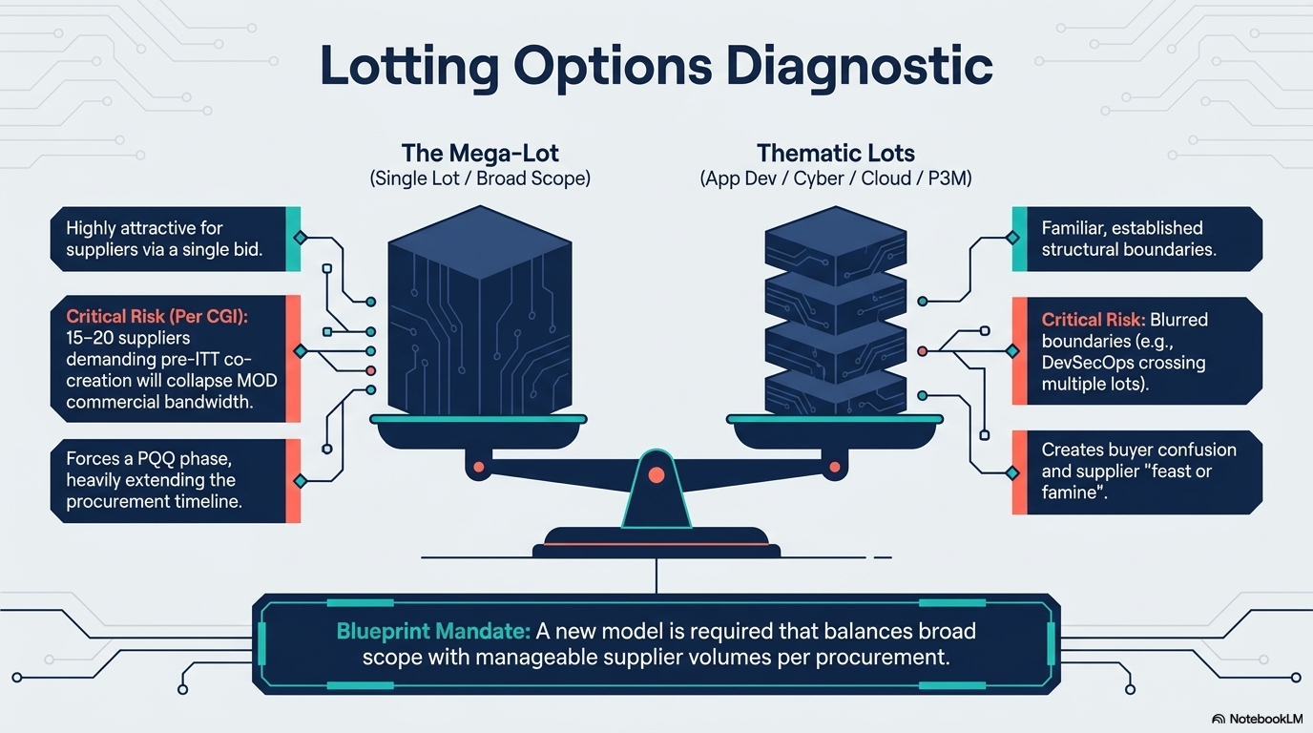
Key approaches to lotting structure design

Slide 34
Lotting structure options considerations
Three options to be considered:
2 lots including a neutral vendor lot
3 lots including a neutral vendor lot
3 lots NO neutral vendor lot
Option 1
Lot 1 Core service delivery (above £5m) | Lot 2 NEUTRAL VENDOR LOT Core service delivery (below £5m)
Option 2
Lot 1 High value and complexity (above £20m) | Lot 2 Medium value and complexity (Between £5m and £20m) | Lot 3 NEUTRAL VENDOR LOT Low value and complexity (below £5m)
Option 3
Lot 1 High value and complexity (£20m+) | Lot 2 Medium value and complexity (Between £5m and £20m) | Lot 3 Low value and complexity (below £5m)

Slide 35
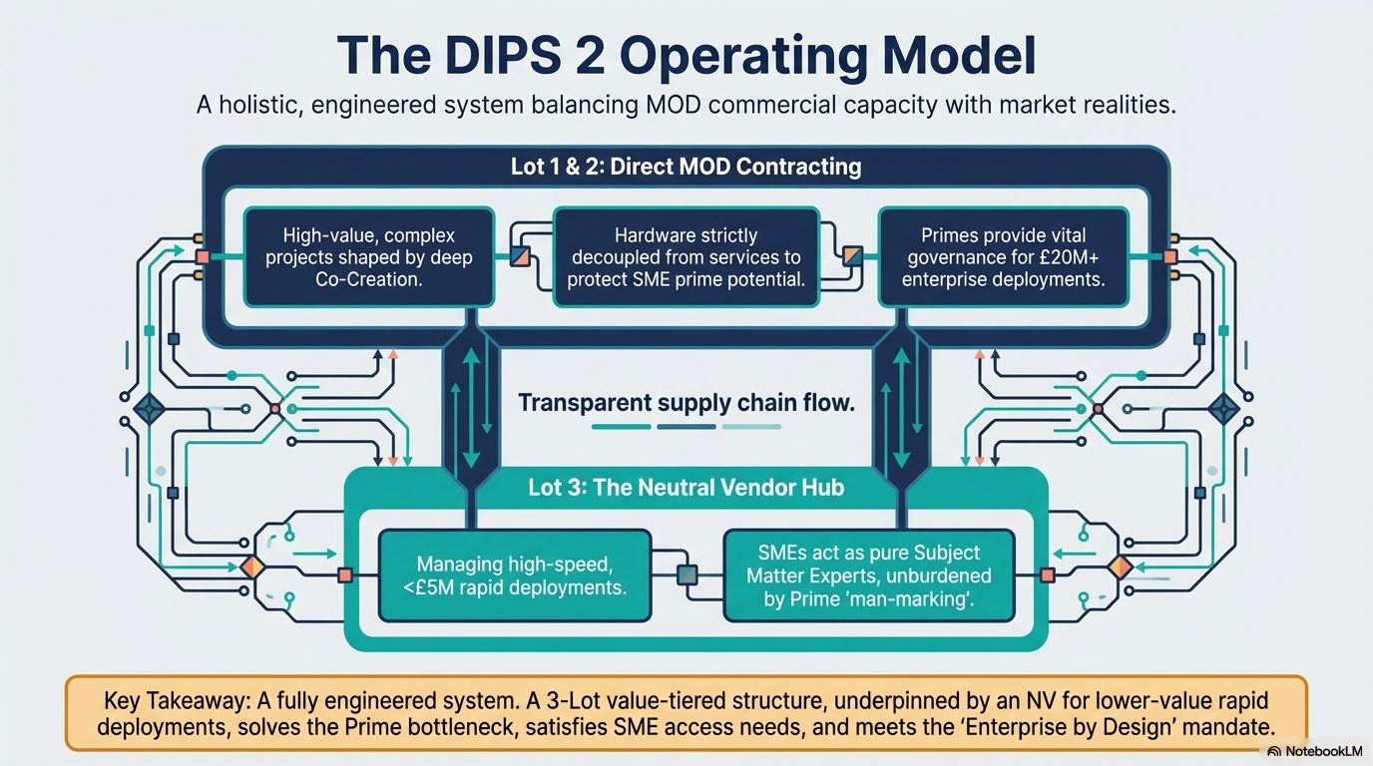
Target operating model

Slide 36
Lotting structure options considerations Option 1
Option 1
Lot 1
Lot 2 NV
Value threshold
Above £5m
Below £5m
Lot 1 Core service delivery (above £5m) | Lot 2 NEUTRAL VENDOR LOT Core service delivery (below £5m)
High barrier to entry
Yes
No
Medium barrier to entry
No
No
Low barriers to entry
No
Yes
Supplier number
Uncapped for onboarding
Capped at 20

Slide 37
Lotting structure options considerations Option 2
Option 2
Lot 1
Lot 2
Lot 3 NV
Value threshold
Above £20m
£5m - £20m
Below £5m
Lot 1 High value and complexity (above £20m) | Lot 2 Medium value and complexity (Between £5m and £20m) | Lot 3 NEUTRAL VENDOR LOT Low value and complexity (below £5m)
High barrier to entry
Yes
No
No
Med barrier to entry
No
Yes
No
Low barrier to entry
No
No
Yes
Supplier number
Uncapped for onboarding
Capped at 10
Capped at 30

Slide 38
Lotting structure options considerations Option 3
Option 2
Lot 1
Lot 2
Lot 3
Value threshold
Above £20m
£5m - £20m
Below £5m
Lot 1 High value and complexity (above £20m) | Lot 2 Medium value and complexity (Between £5m and £20m) | Lot 3 Low value and complexity (below £5m)
High barrier to entry
Yes
No
No
Med barrier to entry
No
Yes
No
Low barrier to entry
No
No
Yes
Supplier number
Capped at 10
Capped at 30
Capped at 40

Slide 39
Neutral vendor overview

Slide 40
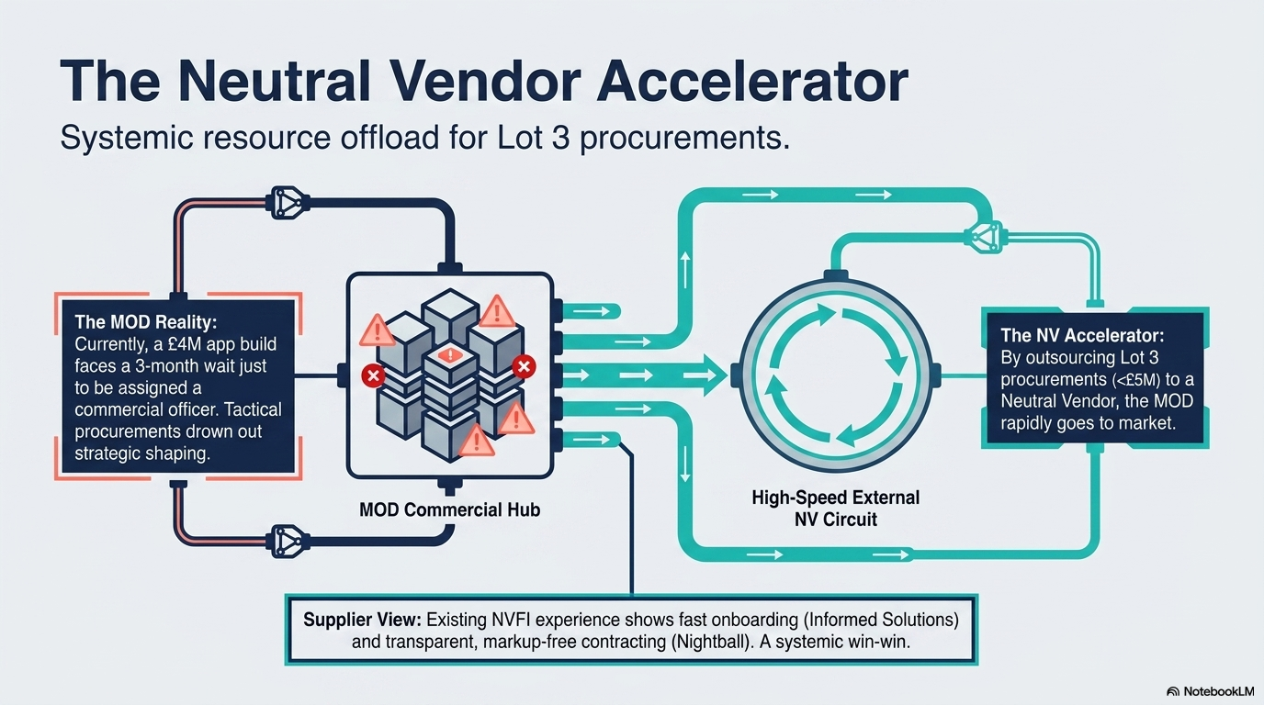
MoD requirement overview - neutral vendor lot

Slide 41
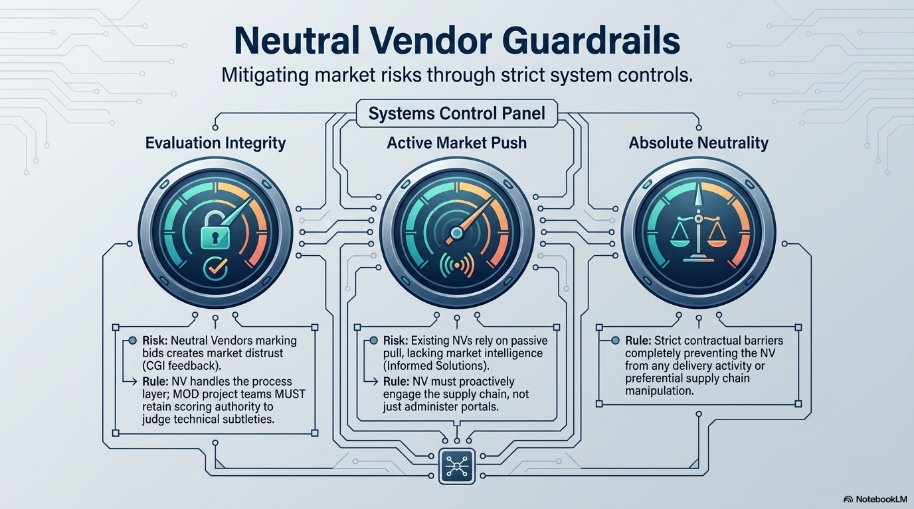
Supplier feedback to date - neutral vendor lot

Slide 42
Slides from May / April pre-market engagement

Slide 43
Professional Services, Consultancy, and Contingent Labour
Professional Services
Not primarily advisory in nature.
Used for delivery of BAU, projects, and programmes.
Delivery-focussed against outcomes/outputs.
Example use case: delivery partner for a complex systems upgrade.
Key route to market:
DIPS (for Digital and IT Professional Services).
Consultancy
Generally advisory in nature.
Used to fill a knowledge gap.
Identifies options and recommendations.
Example use cases include business change and transformation.
Key route to market: Management Consultancy Framework 4 (MCF4)

Slide 44
Professional Services, Consultancy, and Contingent Labour
Professional Services
Not primarily advisory in nature.
Used for delivery of BAU, projects, and programmes.
Delivery-focussed against outcomes/outputs.
Example use case: delivery partner for a complex systems upgrade.
Key route to market:
DIPS (for Digital and IT Professional Services).
Contingent Labour
Generally not advisory in nature.
Used to fill a post that is not or cannot be filled by a Civil Servant.
Use cases include named individual contractors and temporary staff.
Key route to market: Workforce Solutions (aka PSR)

Slide 45
Requirement 1:
Digital Delivery & Product Development
Service Outputs (including, but not limited to)
Discovery, Alpha, Beta, Live delivery
User research, testing and human‑centred design
Product roadmaps, backlogs and acceptance criteria
Service blueprints, journey maps, prototypes
Preparation and support for Service Standard Assessments
Indicative Roles (including, but not limited to)
Product Manager / Senior Product Manager / Product Lead
Delivery Manager / Senior Delivery Manager
Agile Coach / Scrum Master
Business Analyst / Lead Business Analyst
User Researcher / Senior User Researcher
Service Designer / Interaction Designer
Content Designer / Technical Writer
Accessibility Specialist
Design Lead / Head of Design

Slide 46
Requirement 2:
Software Engineering & Application Development
Service Outputs (including, but not limited to)
Secure software development (cloud, on‑prem, hybrid)
API design and system integration
Continuous Integration (CI)/ Continuous Deployment (CD) pipeline development
Test automation frameworks
Legacy remediation and modernisation
Cloud‑native and microservice architectures
Indicative Roles (including, but not limited to)
Software Engineer (all levels)
Senior/Lead Engineer
Full‑stack / Front‑end / Back‑end
Engineer
Application Programming Interface (API) / Integration Engineer
Mobile Developer
Test Engineer, Automation Tester, Performance Tester
Quality Assurance (QA) Lead
DevOps Engineer / Platform Engineer / Site Reliability Engineer (SRE)
Technical, Solution and Enterprise Architects

Slide 47
Requirement 4:
Cyber Security & Information Assurance
Indicative Roles (including, but not limited to)
Security Architect
Cyber Security Specialist
Information Security Analyst
Penetration Tester / Ethical Hacker
Security Operations Centre (SOC) Analyst
Incident Response Specialist
Information Assurance/Risk Specialist
AI assurance
Service Outputs (including, but not limited to)
Security architecture and secure design review
National Cyber Security Centre (NCSC)‑aligned security assessments
Secure by Design accreditation artefacts and risk assessments
Protective monitoring and Security Information and Event Management (SIEM) implementation
Penetration testing and vulnerability assessments
Business continuity and disaster recovery planning
Zero Trust architecture support

Slide 48
Requirement 3:
Data, AI, & Analytics
Indicative Roles (including, but not limited to)
Data Analyst / Senior Data Analyst
Data Scientist / Machine Learning (ML) Engineer
Data Engineer / Senior Data Engineer
Data Architect / Data Modeller
Statistician / Geospatial Analyst
Data Visualisation Specialist
Service Outputs (including, but not limited to)
Data pipelines, ingestion and Extract, Transform, Load (ETL)
Data warehousing and data lake design
Machine learning models and responsible AI assurance
Business Intelligence (BI) dashboards and advanced analytics
Data governance, metadata and cataloguing
Master data management and Reference data management
Data quality assessments, process revision

Slide 49
Requirement 5:
Cloud, Infrastructure & Network Services
Indicative Roles (including, but not limited to)
Cloud Architect / Cloud Engineer
Infrastructure Engineer
Network Architect / Network Engineer
Systems Administrator
IT Operations Manager
Service Outputs (including, but not limited to)
Cloud migration and optimisation
Data centre transformation
Network architecture and secure connectivity
Endpoint management and device strategy
Backup, storage and virtualisation platforms
Operational resilience and Disaster Recovery (DR)/Business Continuity Planning (BCP) implementation

Slide 50
Requirement 6: Technical Assurance & Architecture Services
Service Outputs (including, but not limited to)
Enterprise and solution architecture
Technical options analysis and feasibility studies
Technical assurance for programmes and projects
Compliance assessments against Government Digital Service (GDS), NCSC and IT standards
Technical roadmaps and standards development

Slide 51
Requirement 7:
Project, Programme and Portfolio Management
Service Outputs (including, but not limited to)
Compliance assessments against Project Delivery Standards Gov 002 standards/APMQ
Project, Programme and Portfolio (P3M) governance and reporting
Business case development (Five‑Case Model)
Portfolio planning and prioritisation
Risk and issue management
Benefits management and realisation
Digital transformation programme oversight
Change management
Indicative Roles (including, but not limited to)
Programme Manager
Project Manager
Project Management Office (PMO) Analyst / PMO Manager
Portfolio Manager
Risk Manager
Change Manager
Benefits Manager

Slide 52
Requirement 8:
IT Service Management & Operational Support
Service Outputs (including, but not limited to)
IT service operations (ITIL4‑aligned)
Major incident, change and problem management
Service transition, release and deployment management
Service reporting, dashboards and Key Performance Indicators (KPI)
Asset and configuration management
Indicative Roles (including, but not limited to)
Service Manager
Information Technology Infrastructure Library (ITIL) Process Specialist
Operations Analyst
Major Incident Manager
Service Desk Analysts (1st/2nd/3rd Line)
Release Manager / Change Manager

Slide 53
Requirement 9:
Specialist & Emerging Technology Services
Service Outputs (including, but not limited to)
Artificial Intelligence and responsible AI frameworks
Robotics Process Automation (RPA) implementation
Digital twins and simulation
Internet of Things (IoT) solutions and sensor integrations
5G and advanced connectivity advisory
Blockchain / Distributed Ledger Technology (DLT) exploratory work
Quantum computing readiness assessments
Augmented Reality (AR)/Virtual Reality (VR) and immersive technology for training

Slide 54
SME participation
Option 1
5. Cloud, Infrastructure & Network Services
4. Cyber Security & Information Assurance
6. Technical Assurance & Architecture Services
3. Data, AI, & Analytics
7. Project, Programme and Portfolio Management
2. Software Engineering & Application Development
8. IT Service Management & Operational Support
1. Digital Delivery & Product Development
Lot 1: Core service delivery (>£5M)
9. Specialist & Emerging Technology Services
Lot 2: Core service delivery (<£5M)

Slide 55
SME participation
Option 1
5. Cloud, Infrastructure & Network Services
4. Cyber Security & Information Assurance
6. Technical Assurance & Architecture Services
3. Data, AI, & Analytics
7. Project, Programme and Portfolio Management
2. Software Engineering & Application Development
8. IT Service Management & Operational Support
1. Digital Delivery & Product Development
Lot 1: Core service delivery (>£5M)
9. Specialist & Emerging Technology Services
Lot 1: Core service delivery (>£5M) (Open or Closed Framework)
Likely to be a high bar to entry, evidencing experience and capacity/capability to deliver against all 9 areas of the framework scope.
Lends itself to partnerships, consortia, rather than individual companies.
Ability to build closer, more strategic, relationships with a number of suppliers allowing for co-creation and investment into the MOD.
Potential supplier number caps (depending on whether an Open, or Closed framework is chosen)

Slide 56
SME participation
Option 1
5. Cloud, Infrastructure & Network Services
4. Cyber Security & Information Assurance
6. Technical Assurance & Architecture Services
3. Data, AI, & Analytics
7. Project, Programme and Portfolio Management
2. Software Engineering & Application Development
8. IT Service Management & Operational Support
1. Digital Delivery & Product Development
Lot 2: Core service delivery (<£5M)
9. Specialist & Emerging Technology Services
Lot 2: Core service delivery (<£5M) (Open or Closed Framework)
Likely to be a lower bar to entry, evidencing experience and capacity/capability to deliver against at least 1 area of the framework’s scope.
Lends itself to individual companies, particularly SMEs.
Ability to procure services from SMEs, and niche service providers.
Potential to be an uncapped lot (depending on whether an Open, or Closed framework is chosen)

Slide 57
SME participation
Option 2 Neutral Vendor
5. Cloud, Infrastructure & Network Services
4. Cyber Security & Information Assurance
6. Technical Assurance & Architecture Services
3. Data, AI, & Analytics
7. Project, Programme and Portfolio Management
2. Software Engineering & Application Development
8. IT Service Management & Operational Support
1. Digital Delivery & Product Development
Lot 2: Core service delivery (<£5M)
9. Specialist & Emerging Technology Services
Lot 2: Core service delivery (<£5M) – Neutral Vendor (Closed Framework)
Single supplier Lot (the Neutral Vendor). Not a prime, the Neutral Vendor would not participate in delivery.
Easier way of SMEs doing business with the MoD.
Benefits suppliers through access to the MoD, requirements visibility, meet the buyer events, access to pipeline, and reduced administration.
Allows for increased MoD focus on pipelining.
A high bar to entry, evidencing experience and capacity/capability to deliver volume of procurements for digital and IT professional services.
Neutral vendor approach is in a draft stage of review

Slide 58
Lotting structure options
Three options to be considered:
2 lots split per value
4 lots split per technology category; all lots will include transition and project/programme management provisions; all lots to include ancillary consultancy services; all lots to cover innovation
3 lots including all above requirements+consultancy and assurance services; split per value
Option 1
Lot 1 Core service delivery (above £5m) | Lot 2 Core service delivery (below £5m)
Option 2
Lot 1 Tech strategy, design consultancy and assurance services | Lot 2 Infrastructure, data centre, cloud and networks services | Lot 3 Cyber security, end user and IT service management | Lot 4 Application management and data services
Option 3
Lot 1 Infrastructure, data centre, cloud and networks services Above £5m | Lot 2 Cyber security, end user and IT service management | Lot 3 Application management and data services
Lot 1b Below £5m | Lot 2b Below £5m | Lot 3b Below £5m

