Slide 1
RM6377
Network Services 4
Supplier Surgery

Slide 2
Housekeeping
This session is intended for prospective bidders.
All information in this presentation is provisional and is subject to change.
All information will be superseded by information found in the published bid pack and Tender Notice.
Slides will be shared after the session
We welcome questions during the session
The session will consist of deep dive, FAQ review and open Q&A
The session, in part, assumes that you are familiar with content presented on the 7th July
Notes:
Kim

Slide 3
Conditions of participation
These are mandatory requirements of the Framework and conditions of participation for the competition. Failure to address these conditions of participation may result in your tender being disregarded.
Technical Ability Certificates (TAC) - verify that a bidder has successfully delivered similar work in the past
Financial Viability Risk Assessment (FVRA) - review of bidder account(s)
PPNs:
PPN 014: Cyber Essentials
PPN 015: Prompt Payment
PPN 006: Carbon Reduction Plan
PPN 009: Modern Slavery Risk Assessment
Insurances:
Public Liability Insurance - £1,000,000
Employer’s Liability Insurance - £5,000,000
Professional Indemnity Insurance - £1,000,000
Product Liability Insurance - £1,000,000
All information in this presentation is provisional and is subject to change.
All information will be superseded by information found in the published bid pack and Tender Notice.
Notes:
Kim

Slide 4
Conditions of participation
 | Technical Ability Certificates (TAC) | Financial Viability Risk Assessment (FVRA) | PPN 014: Cyber Essentials | PPN 015: Prompt Payment | PPN 006: Carbon Reduction Plan | PPN 009: Modern Slavery Risk Assessment
Lot 1 | X | Gold | X | X | X | Medium - High risk
Lot 2 | X | Gold | X | X | X | Medium - High risk
Lot 3 | X | Silver | X | X | X | Medium - High risk
Lot 4 | X | Silver | X |  |  | Low risk
Lot 5 | X | Silver | X |  |  | Medium - High risk
Lot 6 | X | Gold | X |  |  | Low risk
Lot 7 | X | Silver | X |  |  | Medium - High risk
Lot 8 | X | Silver | X |  |  | Medium - High risk
Lot 9a | X | Silver | X |  |  | Medium - High risk
Lot 9b | X | Silver | X |  |  | Low risk
Lot 9c | X | Silver | X |  |  | Low risk
All information in this presentation is provisional and is subject to change.
All information will be superseded by information found in the published bid pack and Tender Notice.
Notes:
Kim

Slide 5
FVRA
Deep dive
16th July

Slide 6
What is FVRA?
Financial Viability Risk Assessment (FVRA) is a review of bidder account(s)
Sourcing Playbook
The key principles of appropriate financial testing are:
objective is to determine bidders’ financial capacity to perform the contract
mitigations should be considered
forms part of the overall judgement of suitability during selection
assessments shall be proportionate to the size and nature of the contract, flexible and not overly risk averse
all bidders, whatever their size or constitution, should be treated fairly and not inadvertently disadvantaged by the tests employed
FVRA is a tool we use to access potential risks associated with bidders financial health
The FVRA tool is designed to provide a standardised approach to assessing financial viability
All information in this presentation is provisional and is subject to change.
All information will be superseded by information found in the published bid pack and Tender Notice.
Notes:
Kim

Slide 7

The FVRA tool
The FVRA tool, Attachment 5a, will be provided with the ITT documents
Lead bidders and all consortium members must complete the FVRA and upload it as instructed
Information must be consistent across the FVRA tool and official sources, including, where relevant, details for parent companies
All information in this presentation is provisional and is subject to change.
All information will be superseded by information found in the published bid pack and Tender Notice.

Slide 8
What do we take into consideration?
Value
What are the expected Total Contract Values?
Complexity
How complex is the delivery or expected delivery of the goods/services?
How quickly could organisation switch suppliers or reprocure the contract?
Risk Analysis
What is the potential impact of contract/supplier failure?
How sensitive is the data?
Supplementary areas
Is the product/service being procured commonly available?
Does the market contain small businesses?
All information in this presentation is provisional and is subject to change.
All information will be superseded by information found in the published bid pack and Tender Notice.

Slide 9
Gold / Silver
Lot 1 | Gold
Lot 2 | Gold
Lot 3 | Silver
Lot 4 | Silver
Lot 5 | Silver
Lot 6 | Gold
Lot 7 | Silver
Lot 8 | Silver
Lot 9a | Silver
Lot 9b | Silver
Lot 9c | Silver
Attachment 5a Gold FVRA tool
Attachment 5a Silver FVRA tool
Gold and Silver contracts are for critical products and services, and are typically more complex.
A detailed assessment is needed using the metrics and ratios outlined in Attachment 5a.
All information in this presentation is provisional and is subject to change.
All information will be superseded by information found in the published bid pack and Tender Notice.
Notes:
Kim

Slide 10
Risk classification
For the key areas/ratios displayed in the FVRA, each bidder is assigned a RAG status/risk classification:
Red - High risk
Amber - Medium risk
Green - Low risk
Bidders must set out explanations and provide relevant mitigations on the relevant tabs in the FVRA tool.
It's important to note that a Red/Amber rating does not mean it is an automatic fail. It allows the team to review the mitigating commentary and take such explanations into account.
If GCA requires clarification or further information, it will send a message to the bidder through the eSourcing system.
All information in this presentation is provisional and is subject to change.
All information will be superseded by information found in the published bid pack and Tender Notice.

Slide 11
Gold
Relevant for Lots 1, 2 and 6
 | Low Risk | Med Risk | High Risk
Metric 1 - Turnover Ratio | N/A | N/A | N/A
Metric 2 - Operating Margin | >7% | 4-7% | <4%
Metric 3(A) - Free Cash Flow / Net Debt | >15% | 5-15% | <5%
Metric 3(B) - Net Debt / EBITDA | <2.5x | 2.5 - 3.5x | >3.5x
Metric 4 - Net Debt + Net Pension Deficit / EBITDA | <4.0x | 4.0 - 5.0x | >5.0x
Metric 5 - Net Interest Paid Cover | >4.5x | 3.0 - 4.5x | <3.0x
Metric 6 - Acid Ratio | >1.0 | 0.8 - 1.0 | <0.8
Metric 7 - Net Assets | > Nil | > Nil | > Nil
Metric 8 - Group Exposure Ratio | <25% | 25 - 50% | >50%
All information in this presentation is provisional and is subject to change.
All information will be superseded by information found in the published bid pack and Tender Notice.

Slide 12
Silver
Relevant for Lots 3, 4, 5, 7, 8, 9a, 9b, and 9c
 | Low Risk | Med Risk | High Risk
Metric 1 - Turnover Ratio | N/A | N/A | N/A
Metric 2 - Operating Margin | >5% | 3-5% | <3%
Metric 3(A) - Free Cash Flow / Net Debt | N/A | N/A | N/A
Metric 3(B) - Net Debt / EBITDA | <2.5x | 2.5 - 3.5x | >3.5x
Metric 4 - Net Debt + Net Pension Deficit / EBITDA | <4.0x | 4.0 - 5.0x | >5.0x
Metric 5 - Net Interest Paid Cover | >4.5x | 3.0 - 4.5x | <3.0x
Metric 6 - Acid Ratio | >0.9 | 0.7-0.9 | <0.7
Metric 7 - Net Assets | > Nil | > Nil | > Nil
Metric 8 - Group Exposure Ratio | <25% | 25 - 50% | >50%
All information in this presentation is provisional and is subject to change.
All information will be superseded by information found in the published bid pack and Tender Notice.

Slide 13
TACs
Deep dive
23rd July

Slide 14
What are TACs?
Technical Ability Certificates (TAC) - certification provided by the bidder to verify that a bidder has successfully delivered similar work in the past
Bidders need to complete the TAC (Attachment 2b) for the relevant Lot, providing details about a contract they have completed in the past
The contract must demonstrate delivery of the specific services listed for the designated Lot.
Each Lot will have a different version of the TAC Attachment 2b to complete
Attachment 2b must evidence 1 contract only. This contract example may demonstrate the capability of more than one Lot
All information in this presentation is provisional and is subject to change.
All information will be superseded by information found in the published bid pack and Tender Notice.

Slide 15

Mandatory requirements (same for all Lots)
Contract dates..
that you have delivered in the 3 years prior to the publication of the tender notice for this competition (contract start date after 21st August 2023)
an ongoing contract you are currently delivering that has been ongoing for a minimum of six months
Services must be active, successful in implementation & mobilisation, and fully operational.
OR
Supply chain..
Where your organisation acted as:
Prime Contractor
Key Subcontractor
Part of a Consortium
If relying on other entities, you must explicitly identify:
Who they were
Describe the function each performed under the contract
All information in this presentation is provisional and is subject to change.
All information will be superseded by information found in the published bid pack and Tender Notice.

Slide 16

Cont. Mandatory requirements (same for all Lots)
Types of contracts..
Public sector
Private sector
Third Sector (e.g. charity)
Call-off contracts awarded under framework contracts
Framework contracts themselves
Customer Sign-Off Requirements..
Must be signed by an existing employee of the company for whom the work was undertaken
Customer contacts must not have been employed or appointed by your organisation within the past 3 years prior to the publication of the tender notice (after 21st August 2023)
Physical signatures are preferable, but a digital signature is an acceptable alternative if the customer is unable
All information in this presentation is provisional and is subject to change.
All information will be superseded by information found in the published bid pack and Tender Notice.

Slide 17
TAC requirements per Lot
Lot | Service lines | Minimum Contract Value (ex VAT) | Number of TACs required | Signed within the last 'X' Years
Lot 1 | Internet Connectivity Services (WAN) | £80,000 | 2 | 3
Lot 2 | Local Connectivity Services (LAN) | £100,000 | 2 | 3
Lot 3 | Voice / UC | £90,000 | 1 | 3
Lot 4 | Contact Centre Services | £70,000 | 1 | 3
Lot 5 | IoT & Connected Places | £50,000 | 1 | 3
Lot 6 | Critical Domain Services + detail | £150,000 | 3 | 5
Lot 7 | Messaging, paging and alerting | £10,000 | 1 | 3
Lot 8 | Audio Visual Services | £50,000 | 1 | 3
Lot 9a | Critical Comms Devices | £60,000 | 1 | 3
Lot 9b | Critical Comms Services | £60,000 | 1 | 3
Lot 9c | Critical Comms Software | £60,000 | 1 | 3
All information in this presentation is provisional and is subject to change.
All information will be superseded by information found in the published bid pack and Tender Notice.

Slide 18

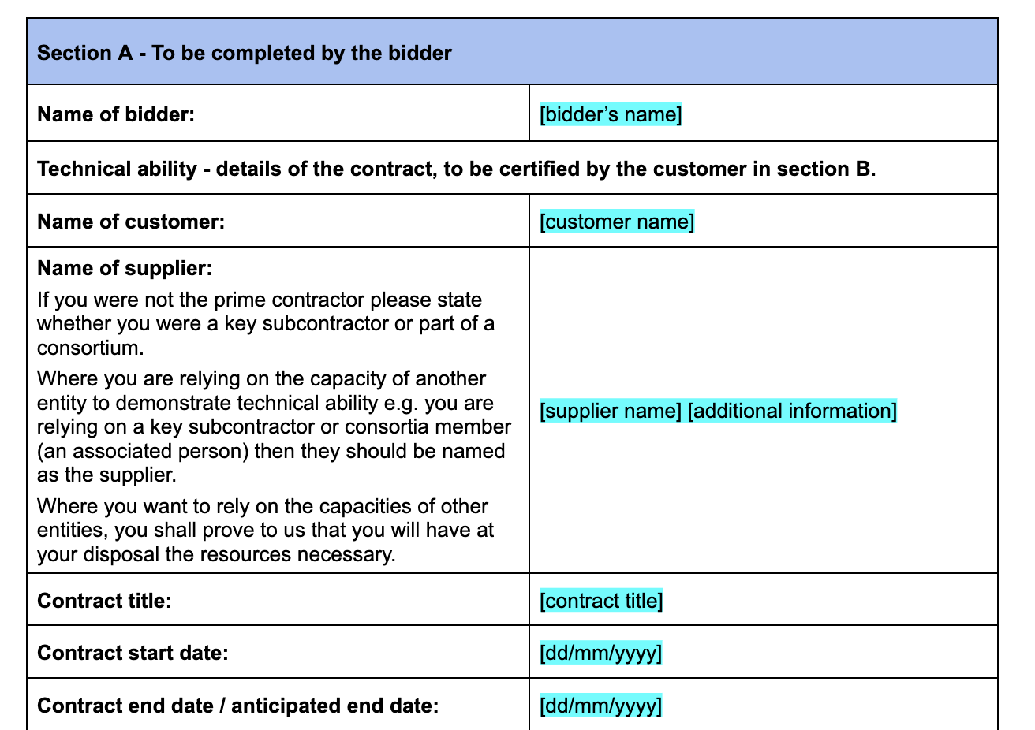
Example Attachment 2b screenshots:

Slide 19
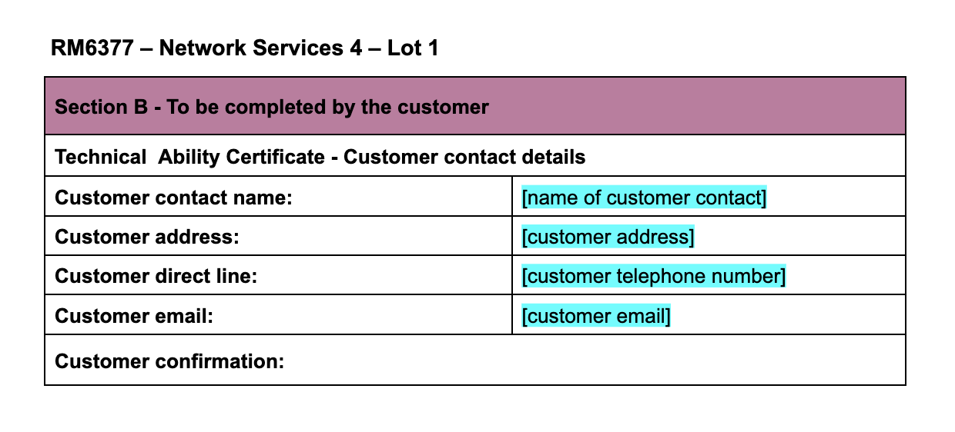
Example Attachment 2b screenshots:

Slide 20
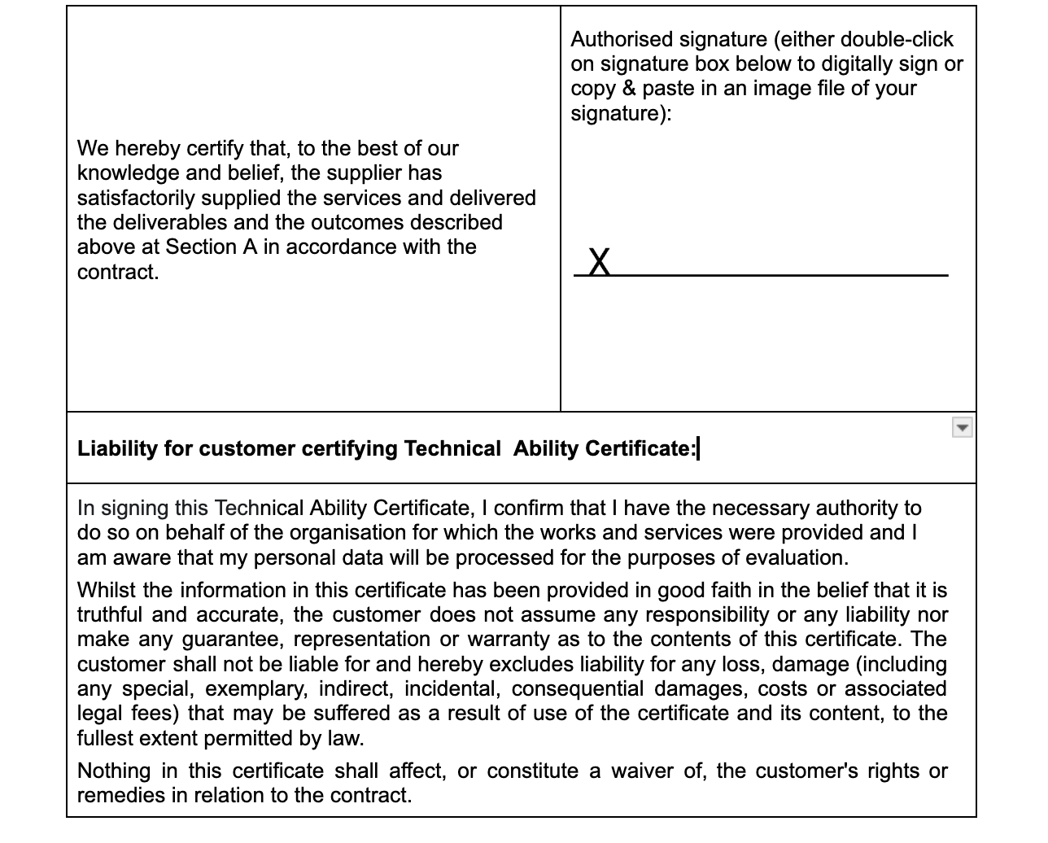
Example Attachment 2b screenshots:

Slide 21
Reminder - Please DO
Ensure that all mandatory requirements listed in Attachment 2b have been met
Double check for errors. You will not be able to amend your TAC after the tender submission
Select a customer that is prepared to verify the information you have provided and be contactable if required
Include details of subcontractors where relevant
All information in this presentation is provisional and is subject to change.
All information will be superseded by information found in the published bid pack and Tender Notice.
Notes:
Kevin

Slide 22
Reminder - Please DON’T
Submit additional documents. Any additional documents will be disregarded.
Use the incorrect TAC - each Lot has its own Attachment 2b with different mandatory requirements
Cross reference to other responses within your tender
Leave any required areas blank - this may result in your tender being disregarded
All information in this presentation is provisional and is subject to change.
All information will be superseded by information found in the published bid pack and Tender Notice.
Notes:
Ralph

Slide 23
PPNs
30th July

Slide 24
PPN 014: Cyber Essentials
Cyber Essentials
Cyber Toolkit (focused on supporting SMEs achieving the certification)
Cyber Essentials Basic = the certificate awarded on the basis of self-assessment, verified by an independent certification body
Cyber Essential Plus may be required by buyers for their call off contracts
Maintaining a certificate and renewal of certificate will be monitored by GCA throughout the framework
All information in this presentation is provisional and is subject to change.
All information will be superseded by information found in the published bid pack and Tender Notice.

Slide 25
PPN 015: Prompt Payment
guidance document for PPN 015
Checker
UK2 or UK3 were published prior to the 01/10/2025 then PPN 015 can apply (NS4 UK2 = 08/09/2025)
Difference = PPN015 average payments days 55 days, PPN018 average payments days 45 days
Paying at least 95% (at least 90% if an action plan is provided) of invoices within 60 days
Meeting the average payment days threshold of at least 55 days for all invoices in at least one of the two previous six month periods, measured over 12 months
All information in this presentation is provisional and is subject to change.
All information will be superseded by information found in the published bid pack and Tender Notice.

Slide 26
PPN 006: Carbon Reduction Plan (CRP)
Must include:
confirming the supplier’s commitment to achieving net zero by 2050 for their UK operations
providing the supplier’s current emissions for the sources included in Scope 1 and 2 of the GHG Protocol, and a defined subset of Scope 3 emissions
providing emissions reporting in CO2e (carbon dioxide equivalent) for the six greenhouse gases covered by the Kyoto Protocol
setting out the environmental management measures in effect, including certification schemes or specific carbon reduction measures the supplier has adopted, and will be able to apply when performing the contract and that support achieving net zero by 2050
publication of the CRP on the bidder’s website
Parent company CRP is ok if the bidding entity is wholly owned by the parent, and they aim to get their own CRP as soon as reasonably practical
All information in this presentation is provisional and is subject to change.
All information will be superseded by information found in the published bid pack and Tender Notice.

Slide 27
PPN 006: Carbon Reduction Plan
How to create a Carbon Reduction Plan
Government-endorsed carbon footprint calculator on the UK Business Climate Hub page which helps calculating your emissions and contains the relevant case studies
Carbon reduction plan training webinar for buyers and supplier
Templates and examples
download the carbon reduction plan template
carbon reduction plan
a carbon reduction plan example for a small sized technology supplier
All information in this presentation is provisional and is subject to change.
All information will be superseded by information found in the published bid pack and Tender Notice.

Slide 28
PPN 009: Modern Slavery Risk Assessment
LOW RISK
Bidders with total turnover of £36m or more per annum and carry out business or part of business in the UK / overseas are required to provide a link or copy of their modern slavery statement - or a satisfactory explanation and assurances.
Bidders with total turnover less than £36m are not required to provide any information
MEDIUM - HIGH RISK
Bidders (regardless of total turnover) are asked to provide a link or copy of their modern slavery statement - or a satisfactory explanation and assurances
Key subcontractors must sign up to CDP, but do not need to provide their own statement
All information in this presentation is provisional and is subject to change.
All information will be superseded by information found in the published bid pack and Tender Notice.

Slide 29
PPN 009: Modern Slavery Risk Assessment
Modern slavery statements should be published in a prominent place on the bidder’s UK website.
Must include:
clearly state that board approval has been given, include the date of approval and be signed by a Director (or equivalent)
detail the steps taken during the financial year to ensure that slavery and human trafficking is not taking place in supply chains and in any part of its own business
set out where supply chains are located
describe the nature of risks in relation to those locations
GCA Guidance
ARTT - for context only, tiering tool used by GCA
All information in this presentation is provisional and is subject to change.
All information will be superseded by information found in the published bid pack and Tender Notice.

Slide 30
T&Cs - PSC
13th August

Slide 31
NS4 T&Cs - Key facts
NS4 will use the Public Sector Contract (PSC) as a basis for T&Cs
Previous iterations of NS frameworks have also used the PSC. The PSC has been updated in line with the new procurement regulations, Procurement Act 2023 (PA23)
Some key updates to the PSC to highlight include:
Old PCR15 PSC had “Core Terms”, New PA23 PSC has “General Terms” - these serve the same purpose and apply to every procurement.
Introduction of new schedules, for example, for IPR and Security.
All information in this presentation is provisional and is subject to change.
All information will be superseded by information found in the published bid pack and Tender Notice.

Slide 32
Framework contract structure
Framework Schedules
Framework schedules form part of the contract that GCA has with each framework supplier, such as the Framework Specification, Order form template, Call Off Procedure and Framework management
General Terms
Framework Award Form
Joint Schedules
Joint schedules are those that apply to both the framework agreement between GCA and a supplier, and to call off contracts between a Buyer and supplier such as Definitions, Insurance, Data Processing.
Some schedules are optional for Buyers to choose at Call Off.
Call Off Schedules
Call Off Schedules are those that apply to the Call Off contract between a Buyer and Supplier such as ICT Services, Staff Transfer, Pricing and Security.
Some schedules are optional for Buyers to choose at Call Off.
.
All information in this presentation is provisional and is subject to change.
All information will be superseded by information found in the published bid pack and Tender Notice.

Slide 33
Framework Model
All information in this presentation is provisional and is subject to change.
All information will be superseded by information found in the published bid pack and Tender Notice.
Authority (GCA)
Framework Contract:
General terms
Framework Schedules
Joint Schedules
Buyer registration
Management charge
Orders and payment
Product, service and invoicing
Buyer
Framework supplier
Call off contract:
General terms
Framework Schedule 6 (Order form)
Call off Schedules
Joint schedules

Slide 34
Call off contracts
General terms apply to every procurement.
For Call Off contracts, some Joint and Call off Schedules are optional, some are mandatory.
Which are optional / mandatory, including the order of precedence of schedules, is outlined in Framework Schedule 6 - Order Form.
NS4 will contain optional Special Terms that can optionally adjust the framework terms for Call Off contracts, that specifically adjust for the market. These will be within the Framework Award Form
TacSys and MVDS2 frameworks in GCA networks category will have similarities in terms
All information in this presentation is provisional and is subject to change.
All information will be superseded by information found in the published bid pack and Tender Notice.

Slide 35
Security Schedules
Modular schedules, developed by Cabinet Office security colleagues
Intended to be more relevant to the nature of a Buyer’s procurement and make clearer the obligations on Suppliers
Adoption in the mid tier model services contract
  Call-Off Schedule 9A (Security: Short Form)
  Call-Off Schedule 9B (Security: Consultancy)
  Call-Off Schedule 9C (Security: Development)
  Call-Off Schedule 9D (Security: Supplier-led Assurance)
  Call-Off Schedule 9E (Security: Buyer-led Assurance)
Schedule remains optional
Buyer guidance available on Gov.uk
Contracting Securely - Modular Security Schedules
All information in this presentation is provisional and is subject to change.
All information will be superseded by information found in the published bid pack and Tender Notice.
Notes:
Modular schedules, developed by Cabinet Office security
colleagues
● Intended to be more relevant to the nature of a Buyer’s procurement
and make clearer the obligations of Suppliers
● Also has adoption in the mid tier model services contract

Slide 36
IPR Schedule
New Call Off Schedule
Aligned to mid-tier contract
Default IPR proposition for each lot linked to the nature of the Services on the lot
Buyers can amend the default IPR option if required
  Option 1 - Buyer keeps ownership of any New IPR
  Option 2 - Buyer retains ownership of any New IPR but the Supplier can use it, subject to Buyer approval
  Option 3 - Supplier keeps ownership of any New IPR
  Option 4 - Supplier keeps ownership of New IPR but the Buyer is given a licence to use it for other contracts and services
All information in this presentation is provisional and is subject to change.
All information will be superseded by information found in the published bid pack and Tender Notice.

Slide 37
Next steps
Bidders to register on Central Digital Platform (CDP) and esourcing suite
Supplier Surgeries
Deep dive topic | Date
FVRA | 16th July
TACs | 23rd July
PPNs | 30th July
No topic | 6th Aug
T&Cs (PSC) | 13th Aug
Supplier Surgeries as weekly drop in sessions - calendar invite to follow this session. Contact us networkservices@gca.gov.uk
1 2 1 conversations Scheduler (30 mins)
NS4 web page for latest updates:
FAQs to be updated regularly
Draft specification for review
Copy of today’s slides
All information in this presentation is provisional and is subject to change.
All information will be superseded by information found in the published bid pack and Tender Notice.
Notes:
Kim

