Slide 1
RM6392 Vehicle Lease, Fleet Management & Salary Sacrifice Car Schemes
November 2025

Slide 2
Welcome and housekeeping
Crown Commercial Service
01.
02.
Introductions and housekeeping
Introduction to Crown Commercial Service, who we are and what we do
The Fleet Category
Current Vehicle Lease Agreement
03.
04.
Overview of the CCS Fleet Category and the solutions we provide for public sector customer
Facts and figures
Policy requirements
RM6392
05.
06.
Guidance on policy requirements and how to prepare
Strategy development & lotting structure
Procurement Act 2023
Q&A and Next Steps
07.
08.
What to expect from the new Procurement Act 2023
Indicative timelines and market consultation

Slide 3




Lease team introductions
Martina Corrin - Commercial Lead
Jessica Cooney - Commercial Manager
Janine Cato - Commercial Manager
Juanita Randles - Commercial Specialist

Slide 4

Housekeeping
Please stay on mute
All attendees are requested to mute their sound to avoid background noise/distractions.
Please add any questions you may have to the chat function and we’ll respond at the end of the presentation
Q&A
Any questions that we cannot answer due to complexity or time restrictions will be dealt with by a post event Q&A which will be shared with you after the event
Timekeeping
Given we have limited time we may not be able to respond to all questions in the chat. Please don’t worry we will include these in a post event FAQ and you will also be able to contact us after the event to ask questions or to provide feedback
Slides
The slides will be available on the RM6392 pipeline page on the CCS website after the event

Slide 5
Crown Commercial Service

Slide 6

Value for the nation
Crown Commercial Service (CCS) connects public and private sectors to achieve the best commercial and procurement outcomes for the UK and its citizens. We call this value for the nation.
Across the whole of the public sector, organisations are faced with:
increased demand for public services
continued financial challenges
expectations of public services that are higher than ever before
As the UK's central commercial and procurement organisation, we:
use our commercial expertise to help customers to buy what they need and achieve best value
ensure customers can focus on what matters most: providing essential public services
Together we can strengthen the economy and society, and support government missions and policy objectives.

Slide 7
Creating value across the nation
Placing customers at the heart of everything we do in:
devolved administrations
health
education
charities / third sector
emergency services
social housing
local government
government departments

Slide 8
The Fleet Category

Slide 9

The Fleet Category Strategy
Our Strategy:
provide Total Fleet Solutions for public sector buyers
provide commercial expertise and market insight to enable effective fleet management
support whole life costing to support best value
help the government and wider public sector meet its policy objectives, for example environmental, social value

Slide 10
The Fleet Commercial Agreements
RM6244: Purchase of Standard and Specialist Vehicles
RM6268 : Vehicle Lease, Fleet Management & Salary Sacrifice Car Schemes
RM6265: Vehicle Hire Solutions
RM6353: Tyres, Glass & Telematics
Currently over 2,000+ customers accessing our agreements
Total “fleet” of approximately 170,000+ vehicles

Slide 11
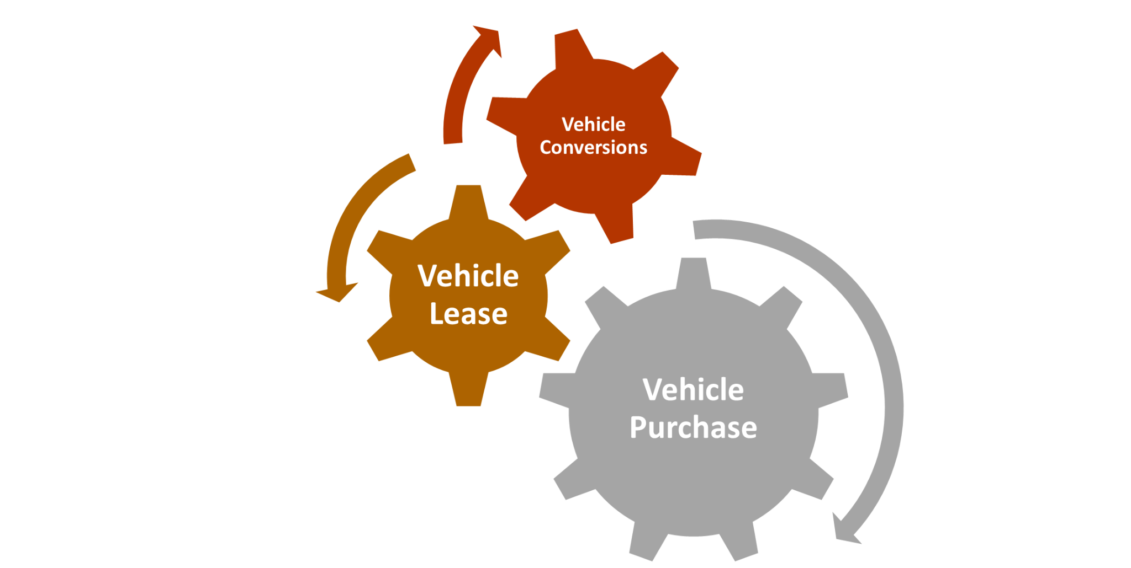
Fleet Framework Relationships
The Fleet Category frameworks are designed to interact with each other to deliver best value to the customer
Funders appointed to the new RM6392 agreement will be defined as “Requesting Bodies”
This status allows access to the CCS support terms (discounts) available from manufacturers on the Purchase of Standard & Specialist Vehicles framework and other applicable agreements
Suppliers must pass on any discounts to the public sector end user

Slide 12
The CCS Fleet Portal
Web based quotation system providing real time vehicle purchase and lease quotations for customers
Supported by two essential data feeds
CAP - providing vehicle data and technical information
Lease suppliers on Lot 1 - providing live quotes for leases of a 2 - 4 year duration with SMR costs, residual value and finance rate
Allows customers to search for vehicles based on operational, environmental and safety criteria, to determine the best value solution
Enables customers to place an award

Slide 13
Current Agreement Performance

Slide 14
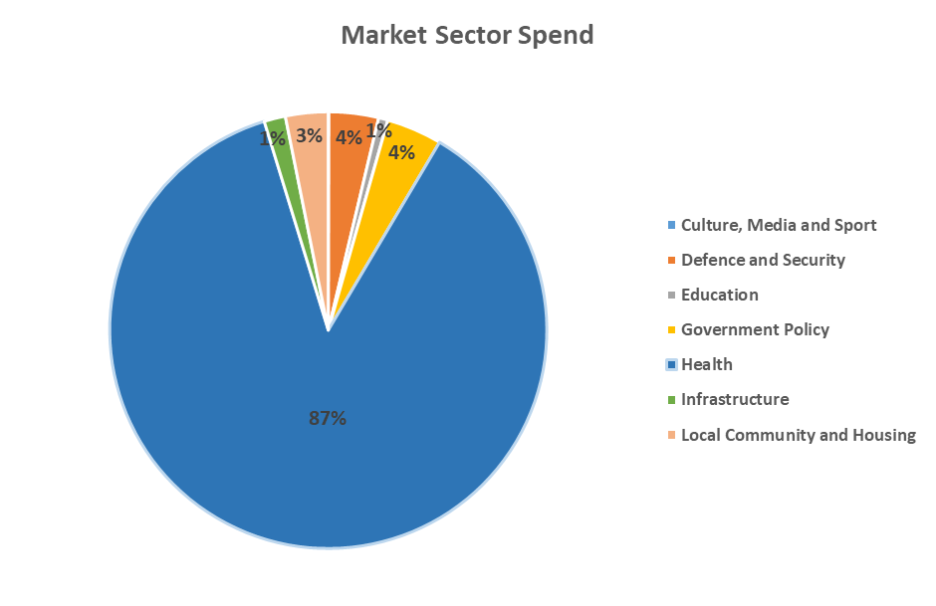
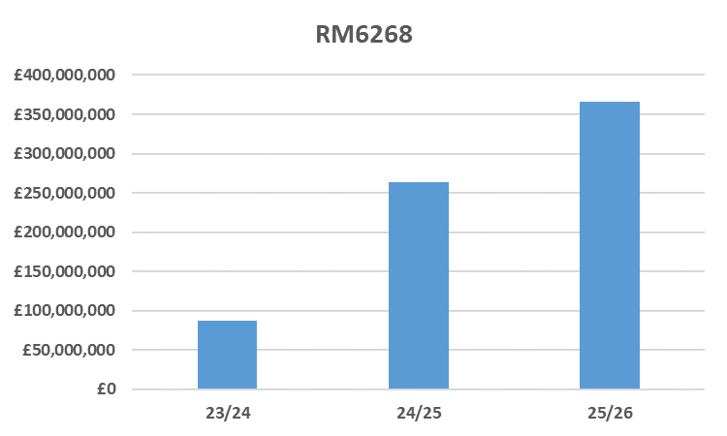
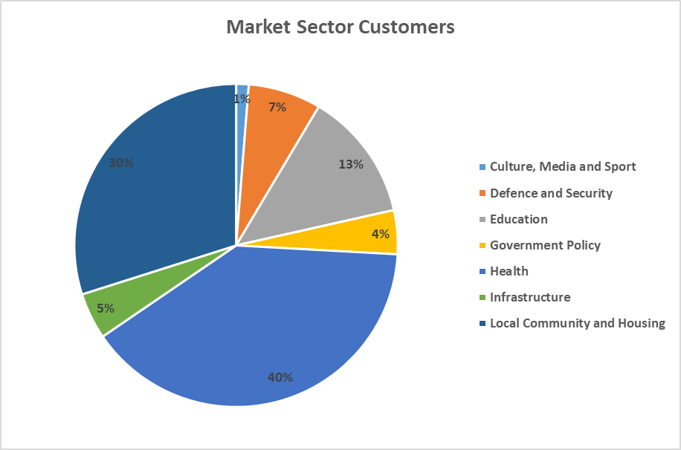
RM6268 - Vehicle Lease, Fleet Management and Salary Sacrifice Car Schemes
Notes:
£717M Spend to date

Slide 15
Vehicle Lease facts and figures - 2024/25
£628M
143K
930+
Total spend by customer across all vehicle lease agreements
Active customers who use the CCS vehicle lease agreements
Total number of vehicles leased through CCS lease agreements agreements
Approx. 80% of vehicles purchased via CCS vehicle purchase agreement are subsequently leased
From customers leasing single vehicles to high volume complex fleets across the whole of the UK.
mix of business, operational and personal use vehicles.
Across all customer types and sectors
Encompasses all types of vehicles and specialist conversions
49.5% Electric
21% Hybrid
18.3% Diesel
11.2% Petrol
Across all customer sectors
96k+ quotes generated via the Fleet Portal in 24/25
Notes:
Across all the Lease Agreements in 24/15 £628M, we are on 90% on target in M7. Past 2 yrs there has been a £100M growth year on yr and set to do the same this year.

Slide 16
Policy Requirements

Slide 17
Crown Commercial Service Policy Event
CCS hosted a session for prospective bidders to share information on government policies relevant to the tendering process.
The session covered the following key areas:
Download the slides from the session to learn more
Carbon Reduction Plans
Social Value and Driving for Better Business
Financial viability risk assessments
Prompt payment
Cyber Essentials

Slide 18

Social Value and Driving for Better Business
All Suppliers will be required to sign up to National Highways’ Driving for Better Business (DfBB) programme by the framework award date to support CCS’ commitment to social value at framework level.
The Driving for Better Business vision is..
“A world where those who use the roads for work do so safely, efficiently, and sustainably”
The programme:
aims to reduce the number of work-related road incidents by raising awareness of work-related road risk, employers’ duty of care and employees’ responsibilities.
helps suppliers comply more easily with regulations and best practice
provides templates for best practice when it comes to driver policies and risk assessments.
provides flexibility as opposed to a ‘one size fits all’ approach

Slide 19

Carbon Reduction Plans
Procurement Policy Note 06/21: Taking account of Carbon Reduction Plans in the procurement of major government contracts
UK commitment to achieve ‘Net Zero’ carbon emissions
PPN 06/21 live since 30 September 2021. Recently amended to align with the Procurement Act 2023 - PPN 006 effective from 24 February 2025
Suppliers bidding for government contracts must commit to achieving Net Zero by 2050 and publish a ‘Carbon Reduction Plan’.
All Suppliers must publish a ‘Carbon Reduction Plan’ and submit it to CCS by the framework award date. Suppliers who fail to make this commitment or publish their plan risk being excluded from the procurement process.
PPN 006 and all associated guidance and FAQs are available here

Slide 20

Carbon Reduction Plans - Training
CCS provides training to help suppliers in the creation of a Carbon Reduction Plan and answer any questions around this requirement.
We will cover
an overview of PPN06/21 and PPN 006
basics of what is needed in your CRP
basics of how to calculate your carbon emissions
areas that must be covered in the plan
the template to be used; and
what not to do
Register for a training session at:
https://www.eventbrite.co.uk/o/crown-commercial-service-38865828613
Next session will be held on Thursday 20 November 2025

Slide 21
RM6392 Strategy & Proposed Lotting Structure

Slide 22
Strategy development
in life commercial agreement assessment
RM6268 and legacy commercial agreements
wider market/industry
customer workshops
customer stakeholder group
supplier engagement
Customer Experience Directorate and Business Development Managers
Internal stakeholder engagement - Government Policy and sourcing approach

Slide 23
Commercial Approach
Compliance with The Procurement Act 2023
Closed framework
-4 year term
Use of standard Public Sector Contract (PSC)
-Short/simple order form
-CCS vehicle lease terms
-CCS vehicle purchase terms
Dynamic lease pricing
-Live quotations for standard passenger vehicles & LCVs
-Future fleet Portal enhancements

Slide 24
Lot 1 Lease of Passenger Vehicles up to [3.5T]
Standard and converted passenger vehicles and LCVs, including minibuses
Providers source vehicles via CCS Purchase of Standard and Specialist Vehicles framework
Suppliers must provide lease quotations for standard vehicles via CCS Fleet Portal
Integration with CCS Fleet Portal is mandatory for all Lot 1 suppliers
Fleet management services - desirable not mandatory
Weight limit for Lot 1 still under review - please share your suggestions with us

Slide 25
Commercial Vehicles, Lots 2a, 2b and 2c
Lot 2a Lease of specialist, commercial and municipal vehicles up to but not including 7.5 tones
Lot 2b Lease of specialist, commercial and municipal vehicles 7.5 tonne and over
Lot 2c Lease of commercial vehicles of all sizes
Introduction of Lot 2c - customer journey
Opportunity to provide fleet management services - not mandatory
No requirement to interface with CCS Fleet Portal
Weight segmentation for Lots 2a & 2b under review - please share your suggestions with us

Slide 26
Lot 3 Salary Sacrifice Car Schemes
Dedicated vehicle salary sacrifice lot
Provision of alternative schemes (non mandatory)
Complements CCS employee benefits solution
Provision of vehicle charging infrastructure (non mandatory)
CCS lease terms not applicable
Funders & non funders
CCS vehicle manufacturer support terms

Slide 27
The Procurement Act 2023

Slide 28
New Terminology
Procurement Act 2023 | Public Contract Regulations 2015
Closed Framework | Framework agreement
Direct award (minister approval) | Different meaning in Procurement Act 2023
Award without competition | Direct award
Award with competition | Further competition
Conditions of participation | Selection criteria
Most advantageous tender (MAT) | Most economically advantageous tender (MEAT)
Preliminary market engagement notice | Prior information notice (PIN)

Slide 29
Timeline & Next Steps

Slide 30

Indicative procurement timeline
February ‘27
November ‘26
June ‘26 to November
‘26
May ‘26 to June ‘26
February ‘25 to May ‘26
Go Live
September ‘25 to December ‘25
Award
Evaluation
period
Tender
period
Internal governance
Market engagement
2025
25/26
2026
2026
2026
2027

Slide 31
Next Steps
Continue to engage with us
Market consultation
-General Terms (previously core terms)
-CCS Lease terms
-Draft framework specification
Feed back your thoughts and views
Help us to define weight segmentation
Contact us if you have further questions
Today’s slides will be shared on the CCS upcoming agreements page for RM6392

Slide 32
Things you can do now
register on the following systems:
Find a Tender
CCS eSourcing tool
bookmark and keep checking for updates on the CCS upcoming deals webpage
get ready to meet policy requirements:
obtain your Cyber Essentials certification
review the Prompt Payment policy and check your processes
attend one of CCS supplier sessions on carbon reduction plans and ensure you have a live CRP
review and sign up to the DfBB programme
request instruction pack for fleet portal interface

Slide 33
Thank You
Thank you for taking the time to join us today, we hope the event has been informative
Contact us: RM6392@crowncommercial.gov.uk

Slide 34
info@crowncommercial.gov.uk
0345 410 2222
www.crowncommercial.gov.uk

