Slide 1
RM6399 Consultancy and Professional Services
(CaPS)
Customer engagement

Slide 2
Welcome and housekeeping
Scope and timeline
01.
02.
Introductions and housekeeping for the session
Overview of objectives including timeline and milestones
Minimum requirements
Spend analysis
03.
04.
Minimum standards, insurances and policies
Overview of the performance of previous CCS management consultancy agreements
Proposed structure
Q&A
05.
06.
Overview of the proposed lot structure for CaPS
Your opportunity to help shape CaPS
Next steps
Closing remarks
07.
08.
Timeline of what to expect next
A thank you for attending and contributing to the session

Slide 3

Housekeeping
Please ensure your video and microphone are off
This session is not being recorded
Slides will be available on the webpage after the final engagement session
We have two hours for this session, approximately 45 minutes for the presentation and then a Q&A session
Please submit all question using Slido, the Q&A will be available of the webpage following the engagement sessions
Please do not use AI note takers or recording for privacy
of attendees who have not had an opportunity to consent
Notes:
All questions must be submitted through Slido - we cannot answer questions in the chat. We are very much exploring options at this stage, nothing is off the table, we strongly welcome all ideas and suggestions at this stage, anything proposed in this session has not been decided or confirmed. This is the time to speak up.

Slide 4
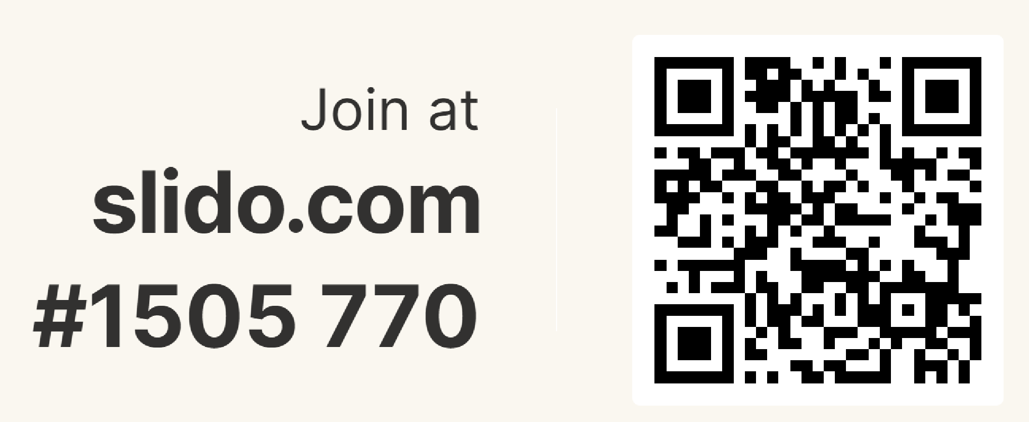
Slido joining instructions
Notes:
Q1 - 3

Slide 5

Indicative timelines
July 27 to August 27
January 27 to June 27
September 26 to December 26
October 25 to June 26
October 25 to February 26
Go live
Evaluation
period
Tender
period
Internal governance
Market engagement
25/26
2025
2026
26/27
2027

Slide 6
Annual requirements for suppliers
Cyber Security
Suppliers are required to have and maintain a cyber essentials certificate.
Insurances
Suppliers required to have and maintain Professional Indemnity, Public Liability and Employer Liability insurance to specific values.
Social value
PPN 002 - Suppliers across all lots will be required to complete and submit an annual social value return.
Self Audit Certificate
Suppliers must prepare and submit an annual self audit and assurance certificate.

Slide 7
PPN 002 Social Value Model - outcomes
Fair work
Skills for growth
Resilient, innovative and flexible supply chains
Sustainable procurement practices
Support the reduction in crime
Employment and training for those who face barriers to employment
Creating a pipeline of opportunities for the contract workforce, reducing barriers to entry for under-represented groups
Increasing productivity through physical and mental wellbeing: in the supply chain and communities in the relevant area
The 8 outcomes under PPN002 Social Value Model are:

Slide 8
Annual requirements for suppliers
Carbon reduction
PPN 006: Suppliers across lots 2 to 8 will be required to submit and annually maintain a carbon reduction plan.
Modern Slavery Act
Suppliers must provide CCS with an annual report stating the steps the organisations has taken to prevent slavery and human trafficking with in it’s supply chain.
Financial stability
Bidders will be required to complete a gold standard financial viability risk assessment on lots 2 to 8 with the standard for lot 1 to be determined.
Prompt payment
Applies to central government contracts over £5 million.
Suppliers are required to pay 95% of invoices within 60 days.
Notes:
Will apply to all Lots except for the SME Lot

Slide 9
Spend analysis

Slide 10
Management consultancy spend
RM6187 MCF3
RM6309 MCF4
£3.6 billion
OJEU value
£1.7 billion
OJEU value
£2.24 billion
TBC

Slide 11
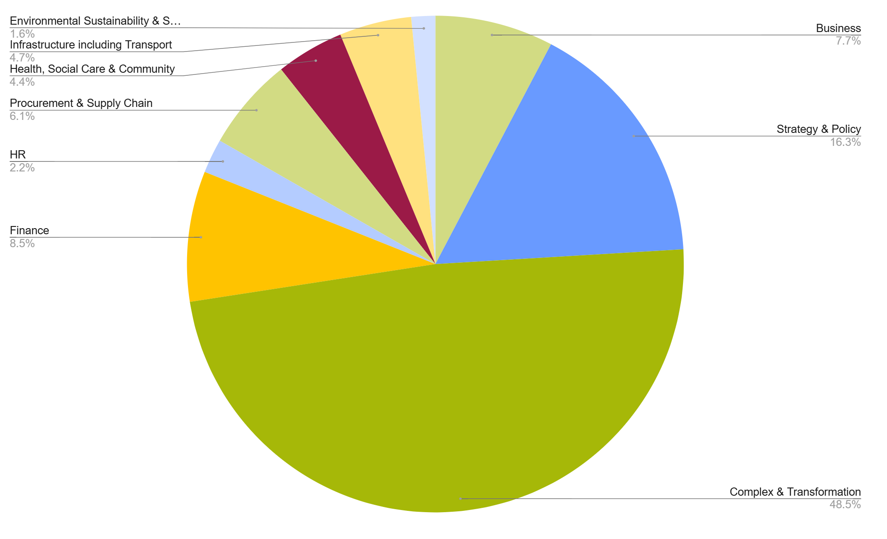
MCF3 spend by lot to date

Slide 12
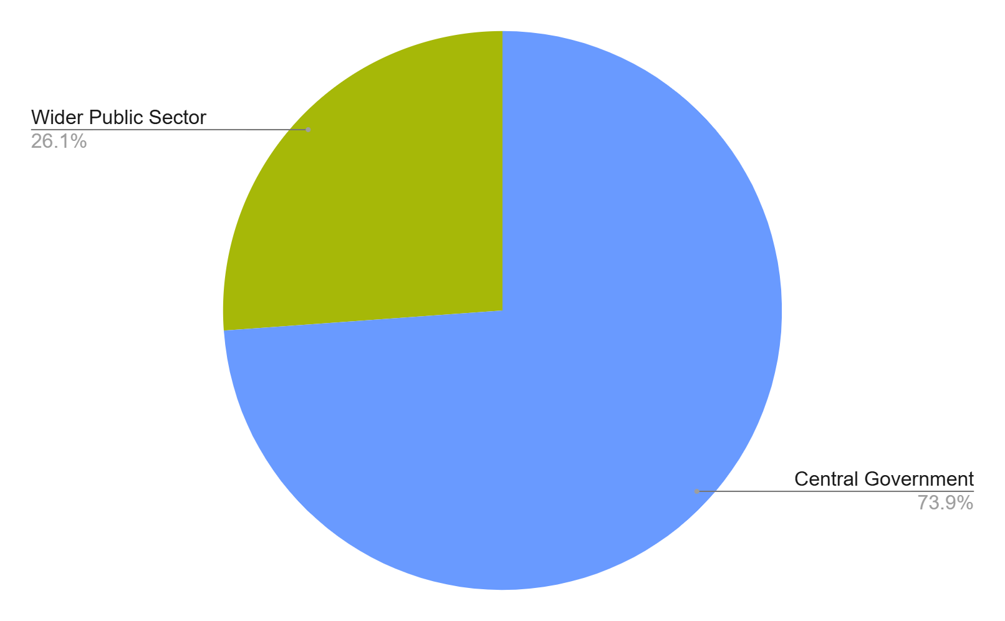
MCF3 sector split to date

Slide 13
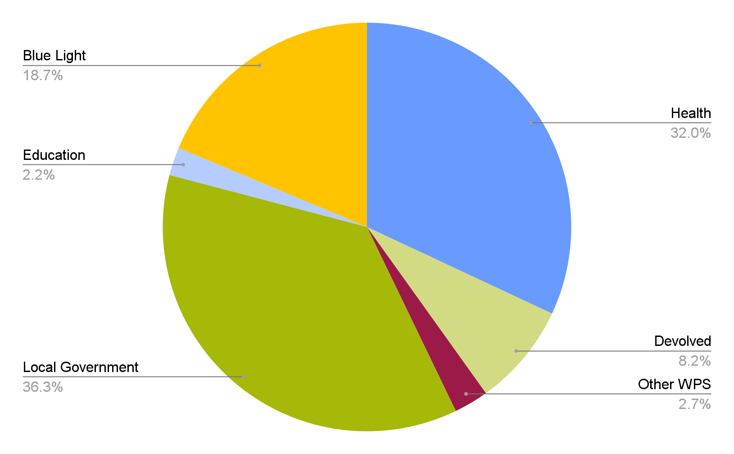
Wider Public sector spend
MCF3 has contracts spanning all sectors.
Devolved administrations includes government organisations in Scotland, Wales and Northern Ireland.
The education sector includes schools, universities and colleges.
Other wider public sector covers non-central government organisations that are not categorised within any of the called out sectors including charities and housing associations

Slide 14
MCF3 - SME overview
2
49
8
4
3
5
5
11
13
3
32
6
3
4
7
5
Business
Strategy and policy
Complex and
transformation
Finance
HR
Procurement and supply chain
18
7
5
SMEs
per lot
10
4
2
SMEs
with spend
Health, social care and community
Infrastructure
including transport
Environmental sustainability
and socio-economic development

Slide 15
Proposed structure

Slide 16
Framework overview
will be a closed 4 year framework under under PA 2023
Public Sector Contract (PSC) to be used
we have streamlined the framework, reducing the number of lots from 10 to 8 while keeping the six grades the same
pricing mechanisms include; Contingent price, Fixed price, Milestone prices, Risk and Reward, Technology enabled services, Time and Materials and Volume based pricing
indexation will be included after year 2 - indices to be confirmed
we have moved from listing our service lines as bullet points to a more descriptive, integrated format. The listings are not an exhaustive list and should be treated as a guide.

Slide 17
Proposed lot structure
Lot |  | No. of suppliers
1 | Multidisciplinary (under £1.5M) | 100 - 150
2 | Strategy and policy | 40
3 | Transformation and organisational design | 40
4 | Corporate (includes Finance, HR & Procurement) | 80
5 | Health & social care | 40
6 | Infrastructure and Public Services (includes transport) | 40
7 | Environment and sustainability | 40
8 | Restructuring and insolvency services | 20

Slide 18
Overview of lot 1 and 4
Lot 1 - Multidisciplinary consultancy
this lot integrates all services detailed within lots 2 to 7 of the framework
it allows for the procurement of a broad spectrum of consultancy and professional services
it is for engagement with a maximum value of £1.5 million (including any extension options)
suppliers bidding for this lot will be unable to bid for lots 2 - 7 of the framework
Lot 4 - Corporate
this lot encompasses financial management, human resources, and procurement
it can be used to procured services in financial accounting and reporting, strategic HR and workforce planning, and optimising procurement processes and supplier relationship

Slide 19
Slido joining instructions

Slide 20
Proposed service lines structure
MCF4 services lines | Examples of proposed CaPS service lines
● Air quality ● Carbon net zero and/or carbon management (including reporting) ● Climate change adaptation and/or mitigation ● Coastal ● Contaminated land and water ● Due diligence ● Environmental planning and protection ● Environmental, social and governance (ESG) ● Feasibility studies and/or impact assessment ● Life sciences ● Monitoring environmental indicators ● Natural capital ● Natural resource management ● Policy development and/or implementation ● Pollution control (including noise) ● Regulatory compliance ● Sustainability ● Waste management | Climate, Carbon and ESG: This covers all high-level planning and reporting. It includes sustainability, climate change adaptation and/or mitigation, carbon net zero and/or carbon management (including reporting), and environmental, social and governance (ESG).
 | Compliance and Due Diligence: This is a dedicated category for all regulatory and transactional services. It includes due diligence and regulatory compliance.
 | Environmental Strategy and Policy: This covers all advisory, high-level planning, and governance. It includes sustainability, environmental, social and governance (ESG), climate change adaptation and/or mitigation, and policy development and/or implementation.
 | Pollution and Remediation: This category is for all services related to controlling and cleaning up environmental issues. It includes air quality, contaminated land and water, pollution control (including noise), and waste management.
 | Technical Assessment and Monitoring: This group includes all scientific and technical analysis. It covers feasibility studies and/or impact assessment, environmental planning and protection, monitoring environmental indicators, natural capital, life sciences, coastal, and natural resource management.

Slide 21
Slido joining instructions
Notes:
Slido Q12 - 14

Slide 22
Technical Ability Certificate (TAC, previously COTPA)
Lot | Number of service lines | Minimum number of service lines to be evidenced | Number of TACs required to demonstrate service lines | Minimum value threshold for TACs
Multidisciplinary | 80 / 6 lots | 1 | 2 per service line | £150k
Strategy and Policy | 10 | 10 | 3 | £500k
Transformation and Organisational Design | 8 | 8 | 3 | £5m
Corporate | 26 | 15 | 6 | £500k
Health and Social Care | 14 | 5 | 3 | £250k
Infrastructure and Public Services | 16 | 4 | 4 | £200k
Environment and sustainability | 5 | 3 | 3 | £100k
Restructuring and Insolvency services | All 7 Primary Capabilities must be evidence across a maximum of 3 TACs. Additional Capabilities can be evidenced by an additional 13 TACs. Sectors can only be offered if a Primary or Additional Capability has been evidenced in that sector using a TAC.
Notes:
Danielle

Slide 23
Q&A session

Slide 24
Next steps
Notes:
Sophie - Q&A from today’s session will be published on the CAPS website after the final session next week. Next round of engagement will be Feb/March 2026 - evaluators strongly needed, please let us know if you would like to help.

Slide 25
Evaluators - key information
We need you!
available between January and March 27 (final dates TBC)
all evaluators will be given training; these sessions will be approximately an hour long
all evaluators will need to attend consensus meetings, likely a couple of days
Please let us know if you would like to be an evaluator by emailing info@crowncommercial.gov.uk referencing ‘RM6399 Evaluator’ in the subject line
Notes:
Sophie

Slide 26

Useful links
RM6399 Consultancy and Professional Services page
CCS events page
CCS upcoming agreements page
RM6309 MCF4 page

Slide 27
Here for you
info@crowncommercial.gov.uk
0345 410 2222
www.crowncommercial.gov.uk

