Slide 1
RM6399 (CaPS)
Demystifying Key Policy Areas
Consultancy and Professional Services (CaPS)

Slide 2
Agenda
Welcome and housekeeping
Carbon Reduction Plans
02.
01.
Introductions and housekeeping for the session
Carbon Reduction Plans context, compliance and PPN 06.
Prompt Payment
04.
Financial Viability Risk Assessments
Overview of FVRA.
03.
Overview of Prompt Payment Policy and PPN 015.
Next steps and Closing remarks
05.

Slide 3

Housekeeping
Please turn off your microphone and camera
This session is not being recorded
The sessions will last approximately 1 hour 30 minutes
Slides will also be available on the webpage after the engagement session
Do not use AI note takers or recording for privacy of attendees who have not had an opportunity to consent

Slide 4


PPN 006
Carbon Reduction Plans context and compliance
Marta Hyder
CRP Compliance Lead
Net Zero 2050
Notes:
https://www.ncei.noaa.gov/access/monitoring/monthly-report/global/202502

Slide 5
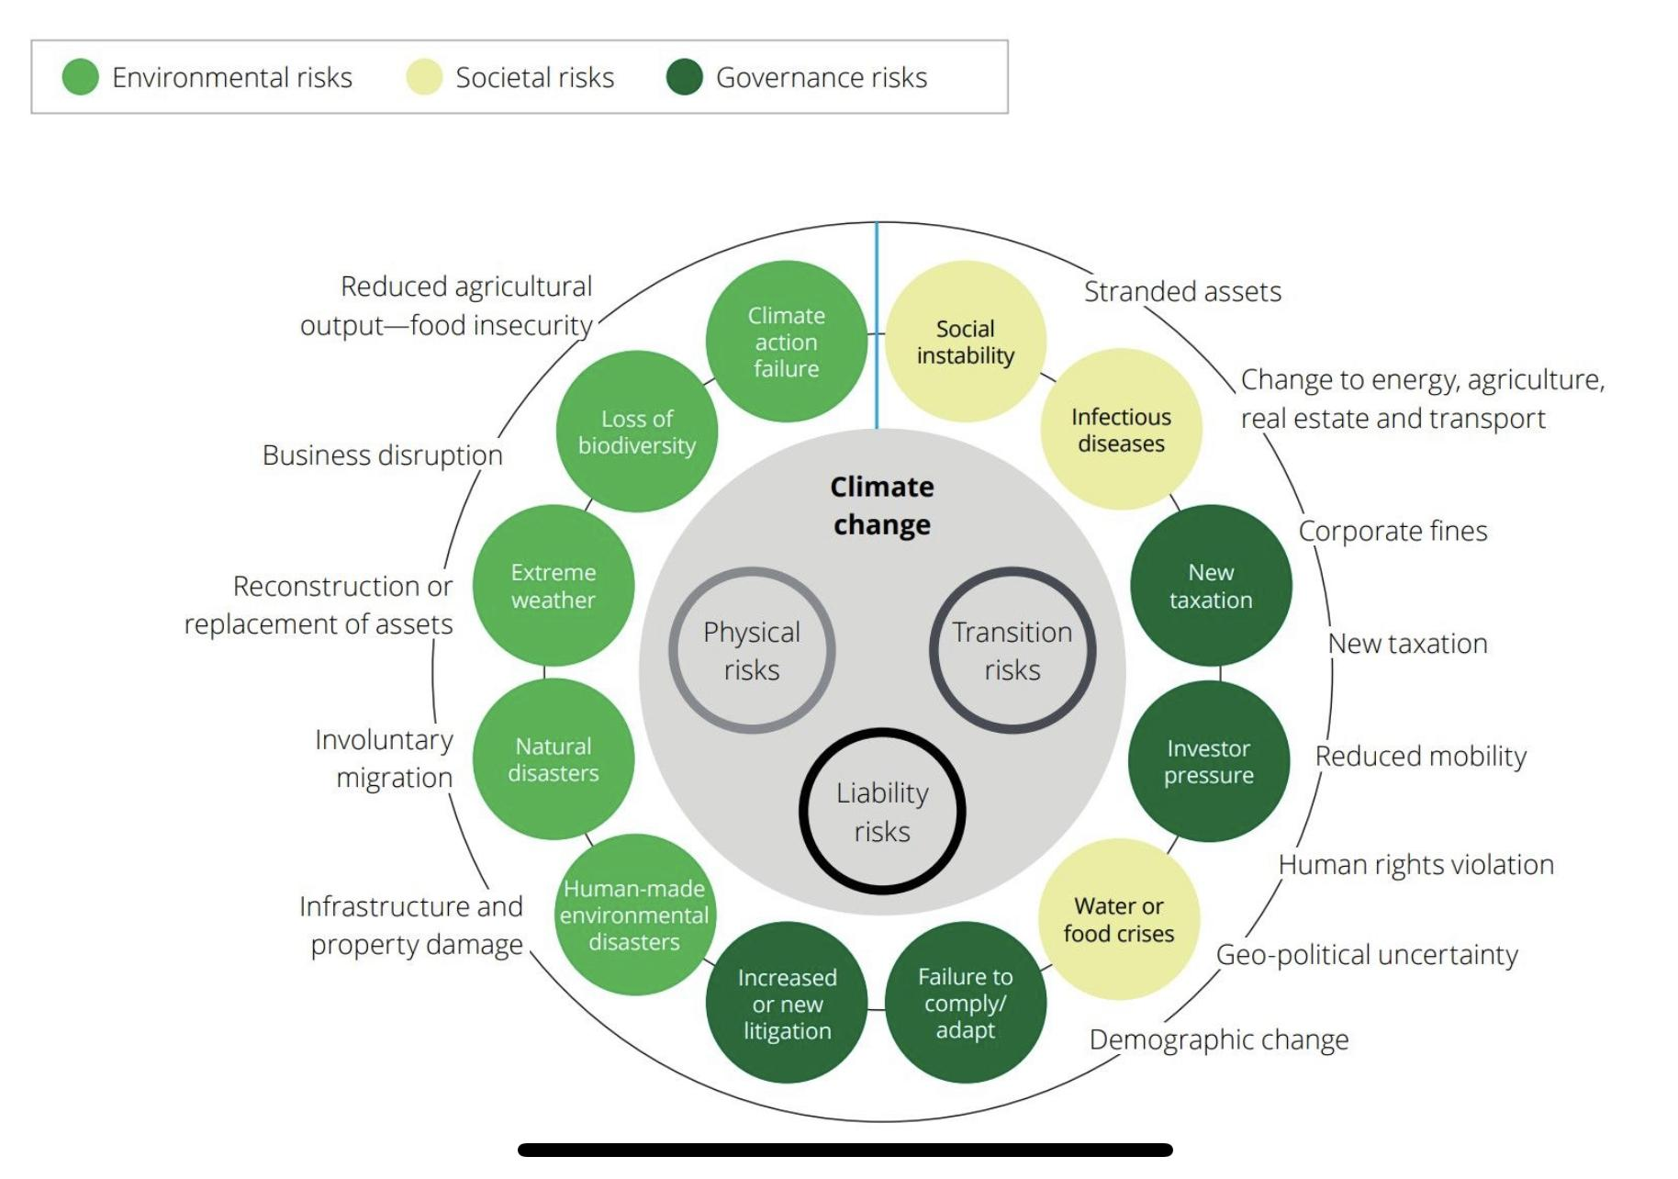

Consideration for your business
Source: World Economic Forum Global Risks Report 2020

Slide 6
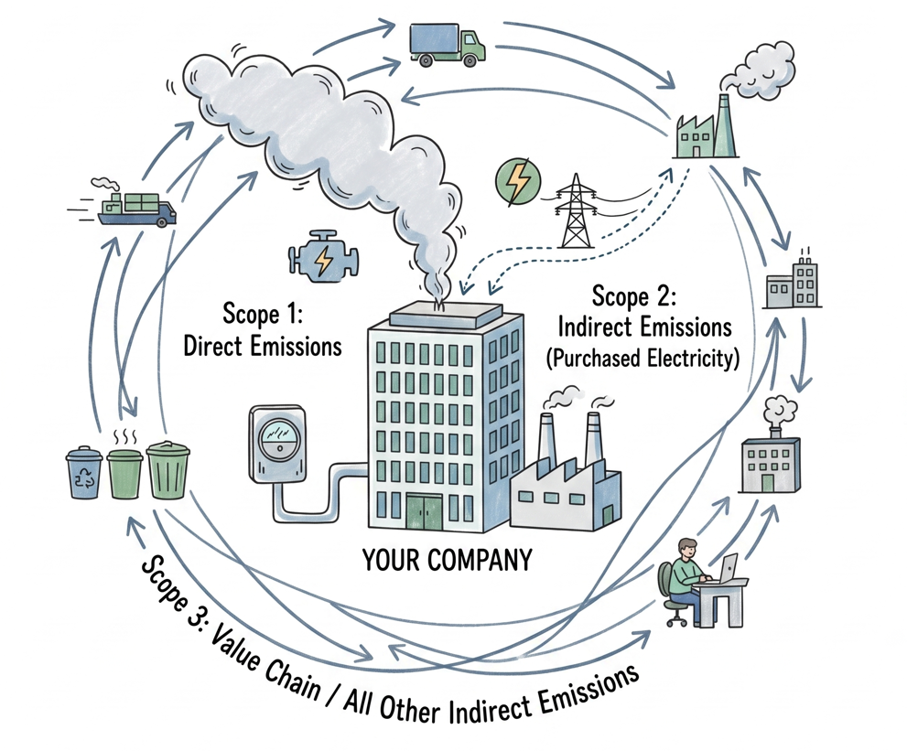
Your role: get to know your carbon footprint - Scope 1, 2 and 3

Slide 7

Scope 1 - Energy - Direct Emissions
Direct emissions from companies owned assets or controlled sources. Include on-site Energy sources like Natural Gas, Fuel and Refrigerants, Combustion in Boilers and Furnaces.
Emissions from all company Fleet vehicles (vans, trucks, cars, helicopters) - increasingly reducing as alternative fuels enter market

Slide 8

Scope 2 - Electricity - Indirect Emissions
Scope 2 Indirect GHG emissions arise from the purchase of Energy. Primarily in the form of Electricity &, Cooling
These are generated off-site and purchased by your company. They are indirect because they are produced by someone else, but you use them.
Methods: Market based vs location based
Note: Scope 2 consultation is in process - expect stricter approach from 2027 onwards.

Slide 9

Scope 3 - Supply Chain - Upstream and Downstream
Scope 3 is all about how a product or service gets to you, and subsequently what is done with it thereafter.
These emissions are not under your direct control, hence why not easily actionable.
A way to reduce these emissions is to work with your Supply Chain to change how they manufacture or find an alternative supplier who may make something differently

Slide 10

We understand that reporting Scope 3 categories
may be challenging…
You must report against all Scope 3 categories defined in the Technical Standards. The relevant narrative is needed when any of them is not applicable or in the process of being measured.
You are free to use any category out of the total of 15.
Working From Home is reported under Employee Commuting
Check the below guidance:
Technical standard for Completion of Carbon Reduction Plans
Greenhouse Gas Protocol - Technical Guidance for Calculating Scope 3 Emissions

Slide 11

Principles of a compliant CRP
transparency
narrative
diligence
perspective
accountability

Slide 12
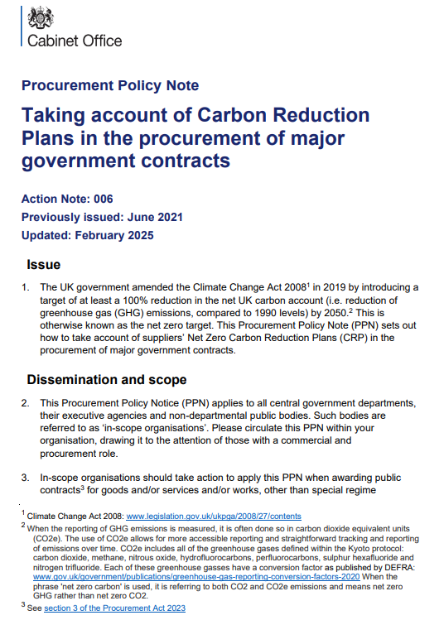
Procurement Policy Note (PPN) 006
Resources available on the PPN 006 website.
PPN 006 live 24th February 2025
previously PPN 06/21 applicable from September 2021
Procurement Policy Note 006
Technical Standards on Creating your CRP
Guidance on Adopting and Applying
Carbon Reduction Plan Template

Slide 13
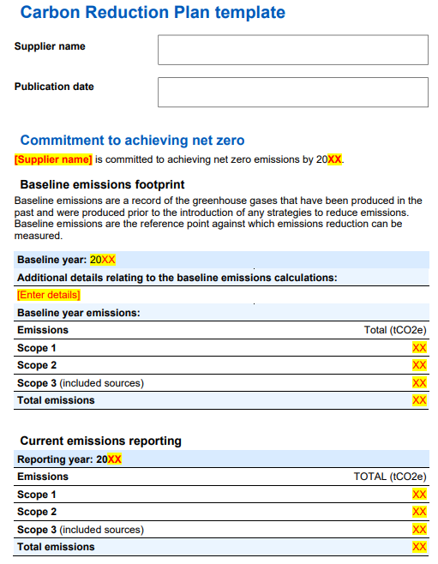

Your Supplier name must be exactly as the bidding entity name
Publication date must be within 12 months to enter the procurement process.
Your commitment to achieving Net Zero by 2050 (or earlier).
Baseline emissions are the emissions calculated for the first time, before any improvements and reductions solutions.
Current emissions is a complete 12 month cycle.
Should be within no more than 18 months to enter the procurement process.

Slide 14

Your Publication date must be within 12 months to participate in tender
Start and end months are for all reporting periods must be aligned.
All emissions must be reported in tonnes
Your commitment to achieving Net Zero by 2050 (or earlier).
Your baseline and current reporting year can be the same, if this is your first year of reporting or if you decided to rebaseline
Baseline emissions are the emissions calculated for the first time, before any improvements and reductions solutions.
Be honest - for various reasons it may happen that your current emissions are higher
Current emissions is a complete 12 month cycle.
Should be within no more than 18 months to enter the procurement process.

Slide 15
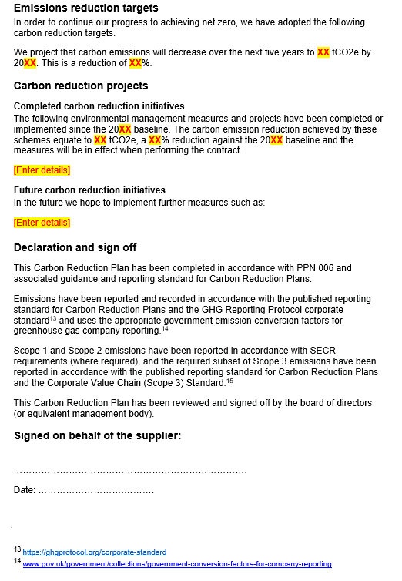
Reduction targets you think you can achieve. You may want to define intermediate targets.
Measures and projects that you have put in place your ongoing initiatives and future ambitions.
Narrative is key!
Signed off by a Director (or equivalent senior leadership), and dated along with the full name and position of the signatory. Doesn’t need to be a “wet” signature.
Must be prominently displayed on the company’s website.
Recommendation: Your CRP should count 10 pages maximum

Slide 16
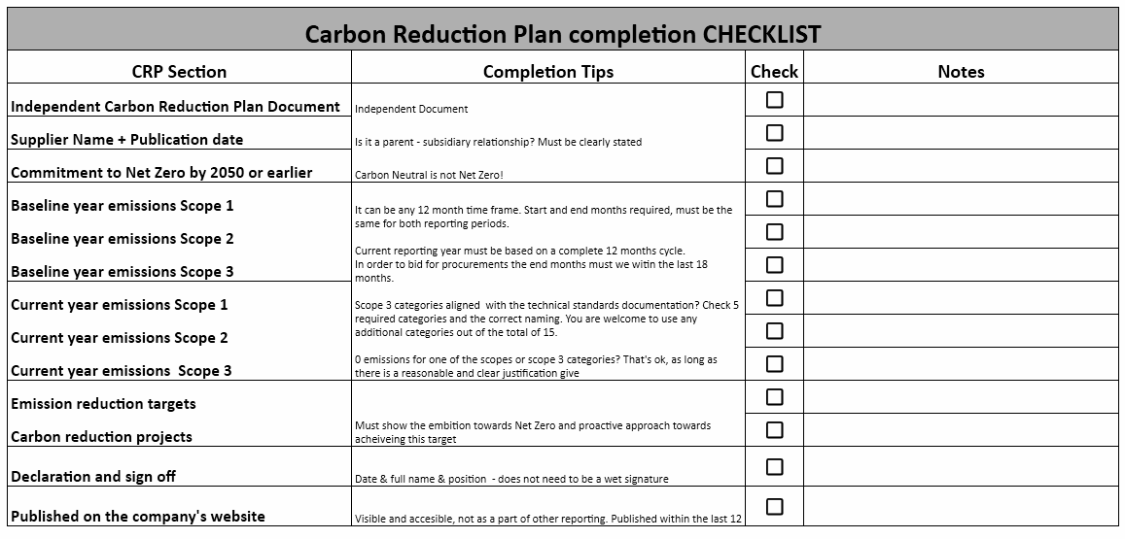

Slide 17
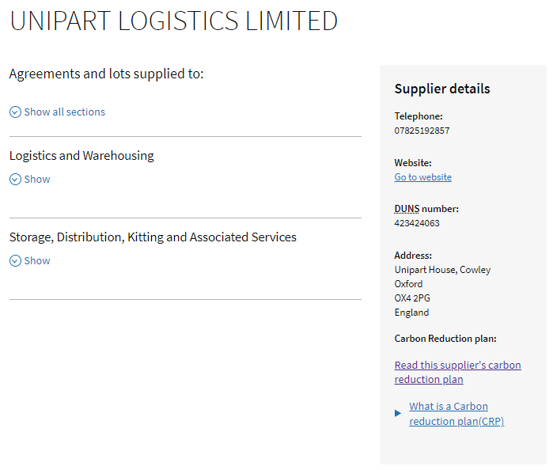
Compliant CRP is displayed on the CCS Website
Supplier provides the URL with their CRP
We update the Internal CCS database
Carbon Reduction Plan label is displayed on the CCS website next to your name
Search for your supplier record here
Let us know about any changes so we can keep
your records up to date
The URL with supplier’s CRP is available inside the supplier record
Keep in touch
and let us know about any changes

Slide 18
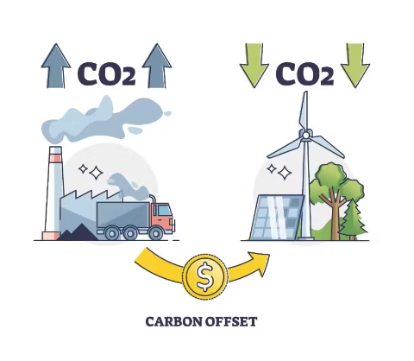
Carbon Offsetting / Neutrality
the need of the climate is to reduce carbon, to move away from fossil fuels, and to re-shape our economy to changing to cleaner and greener ways of working, for example renewable energy
for this reason therefore, we do not accept carbon offsets as being equivalent to actually reducing carbon
carbon offsetting credits and carbon neutral certificates are not the same as actually reducing carbon through the Carbon Reduction Plan process

Slide 19



Carbon Reduction Schedule
Procurement Policy Note 016 Carbon Reduction Contract Schedule
Its purpose is the reduction of contract-level GHG Emissions and supporting the UK
government's commitment to achieve the Net Zero Target by 2050.
Optional Carbon Reduction Schedules are now included in our new agreements
Customers can produce industry and contract specific objectives to monitor and reduce emissions throughout the life of the contract.
Customers can include wider sustainability requirements
Check the example contract template here
Please ensure to refer to the actual framework you wish to bid on as the template is always adapted for the market.

Slide 20

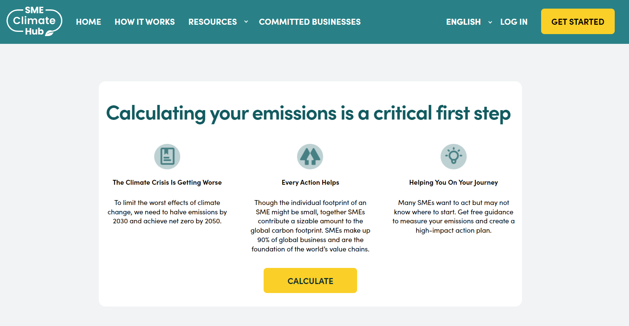
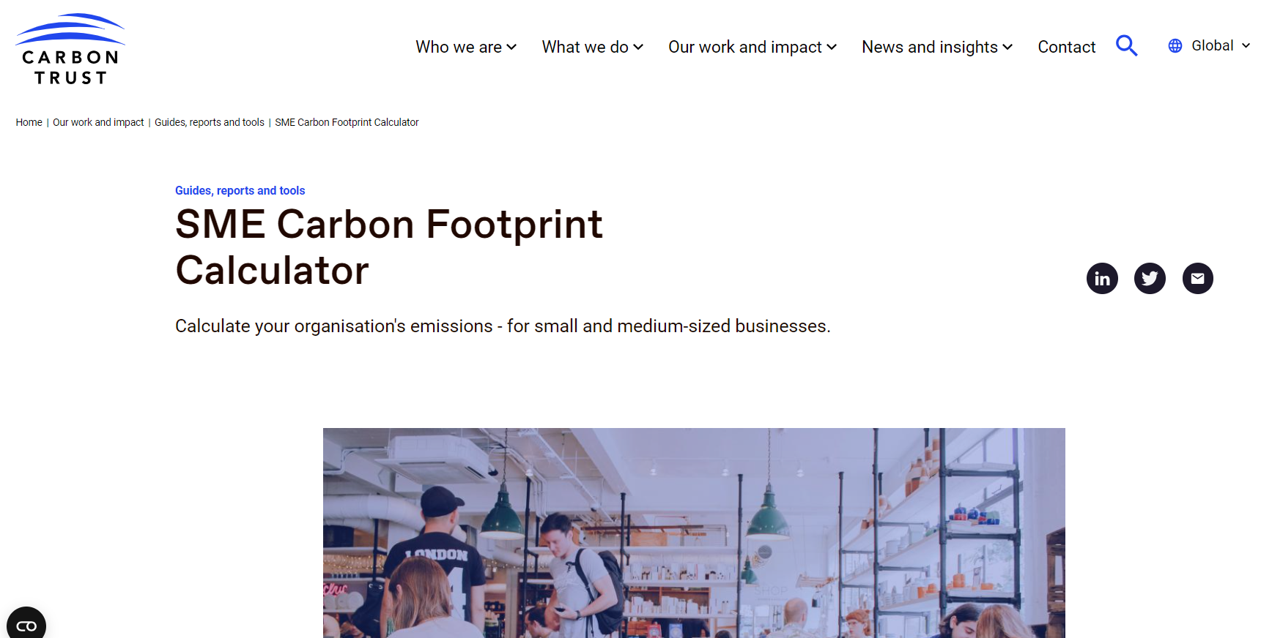
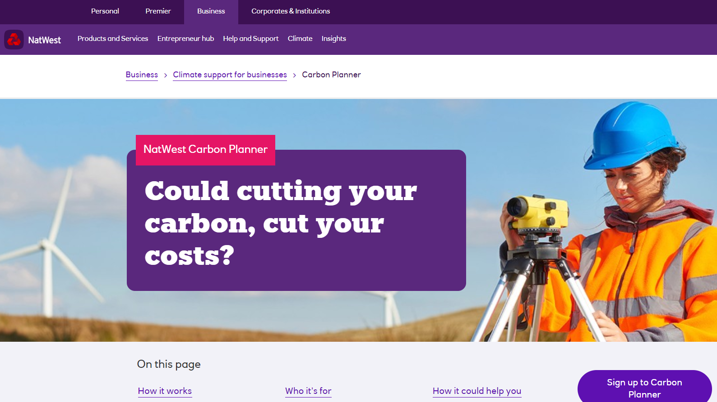
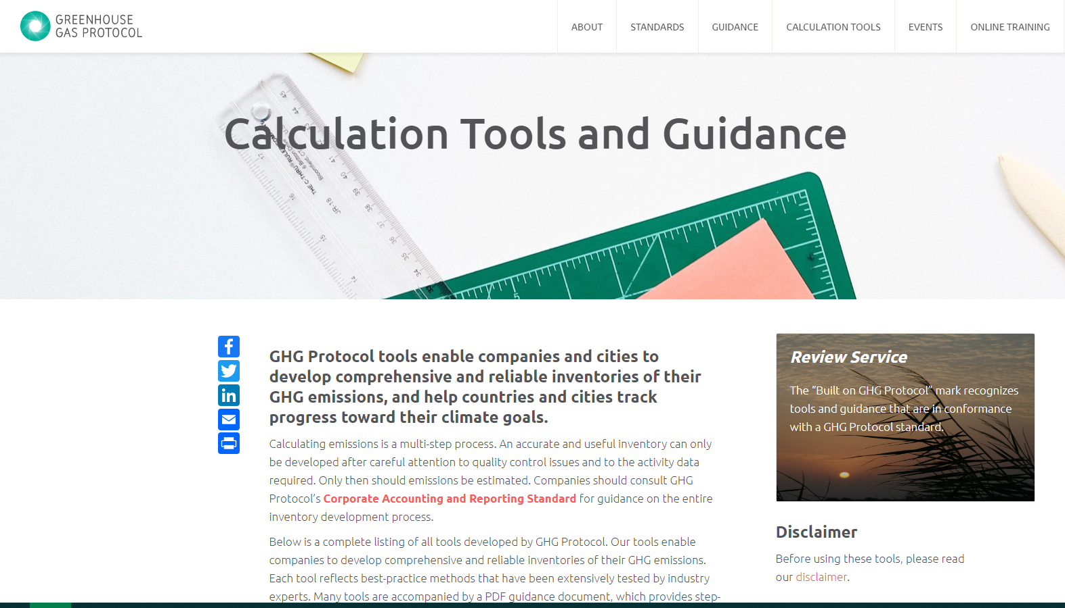
UK Business Climate Hub
Information and resources
Free calculators and tools
Case Studies
https://businessclimatehub.uk/
SME Climate Hub
Aimed at SME’s
Developed with Google
Carbon Trust
Aimed at SME’s
Includes Scopes 1+2
NatWest Carbon Planner
Aimed at all UK Businesses
Developed with 2,000 organisations
GHG Protocol Calculator
Aimed at large businesses and government
Excel spreadsheets and sector differences

Slide 21

Here for you
marta.hyder@gca.gov.uk
CRP@gca.gov.uk
info@gca.gov.uk

Slide 22
Prompt Payment

Slide 23
Prompt Payment Policy
Procurement Act 2023:
Clauses 68 and 73 automatically imply the requirements to include 30 day payment terms into any contract and subcontract used to deliver goods or services to the public sector - For GCA this is found in the Public Sector Contract.
Invoices must be paid within 30 days from the point of receipt, in line with private sector reporting.
Public sector organisations must publish their payment performance on an annual basis.
Payment Compliance Notices must be published every six months detailing compliance with paying invoices within 30 days from receipt.
Notes:
The Procurement Act 2023 came into effect on February 24th 2025 and features updated clauses that automatically imply 30 day payment terms into all public sector contracts, and subcontracts for goods or services. GCA implements this in all contracts used for our frameworks, including our standard T&Cs - the Public Sector Contract (PSC for short).

Slide 24
PPN 015
PPN 015 came into effect and replaced PPN 10/23 on 24th February 2025. It must be included in the Selection Questionnaire for any contract valued above £5m per annum, including frameworks with expected call-offs exceeding this value.
It requires suppliers to demonstrate they have effective payment systems by:
1. Paying at least 95% of their invoices within 60 days of receipt, or pay at least 90% of invoices within 60 days and submit a detailed action plan on how they will improve.
2. Paying all of their invoices within an average of 55 days.
A supplier must provide evidence it has met both of these criteria during at least one of the two previous six-month reporting periods, otherwise they will be unable to bid for government contracts. Evidence may be provided using Payment Practice Reports published under the Reporting on Payment Practices and Performance Regulations 2017.
Notes:
PPN 018 came into effect on October 1st 2025 and applies to frameworks advertised on or after this date. PPN 018 is unique from other PPNs in that it states that ‘advertised’ refers to the publication of a UK2 or UK3 notice. As the UK2 notice for this framework was published before October 1st 2025, PPN 015 will still apply instead of PPN 018 and its updated requirements.

Slide 25
Here for you
info@gca.gov.uk
0345 410 2222
www.gca.gov.uk

Slide 26

Economic & Financial Standing
Mark Pepperell
Head of Commercial Finance
An Overview of the FVRA process

Slide 27




The Playbooks
The sourcing playbook has 11 key policy reforms
Requirement for Pilots
Publication of Commercial Pipelines
Risk Allocation
Market Health & Capability Assessments
Pricing & Payment Mechanisms
Project Validation Reviews
Resolution Planning
Delivery Model Assessments
Key Performance Indicators
Should Cost Modelling
Assessing Economic & Financial Standing

Slide 28
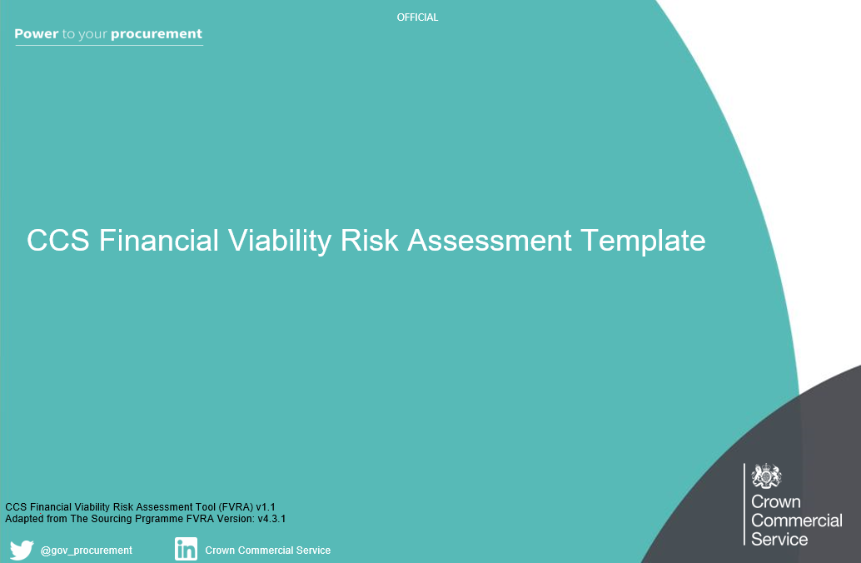

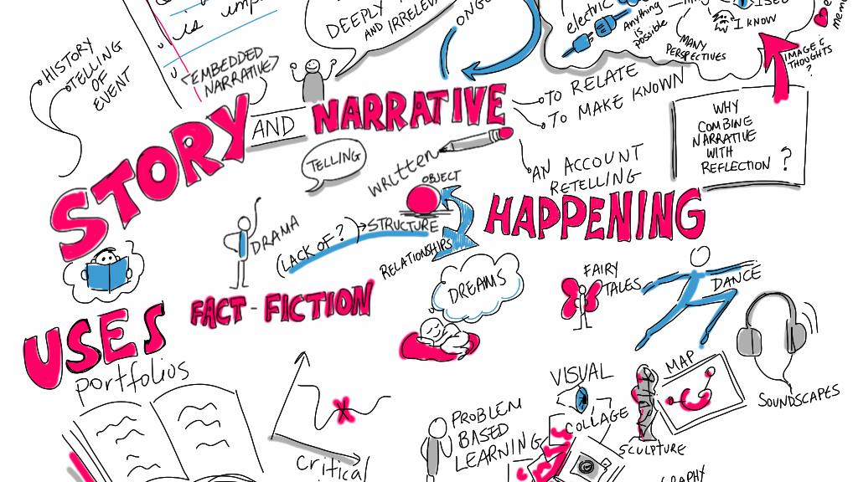
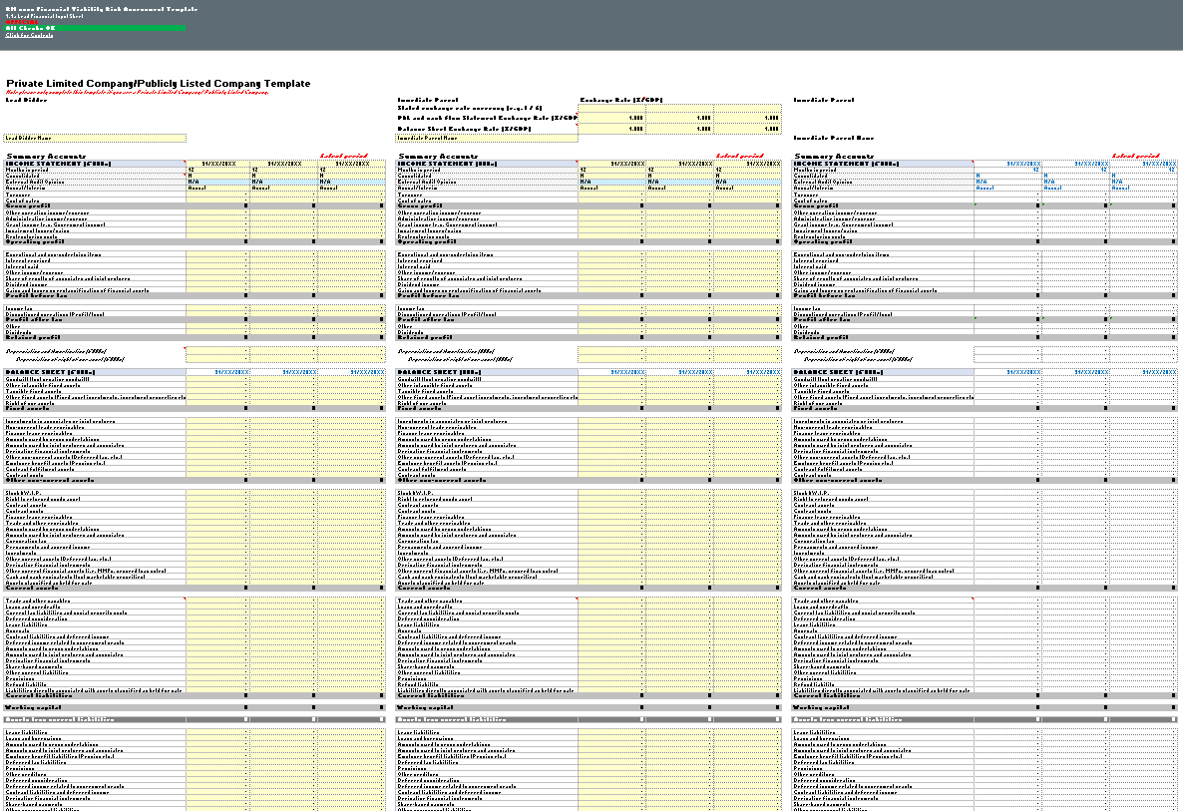
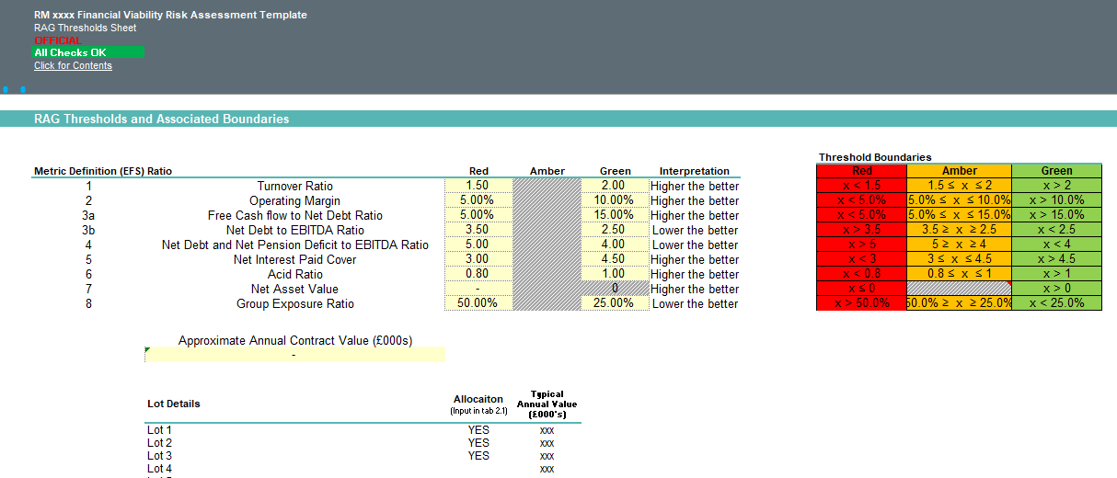



The FVRA
The Financial Viability Risk Assessment (FVRA) tool is the prescribed tool for assessing financial risk
Financial metrics and expectations clearly communicated
Bidders can provide commentary to mitigate RAG outcomes
Bidders Populate Tool
Bidders see initial outcome before submission
Reviews 3 upto entities

Slide 29
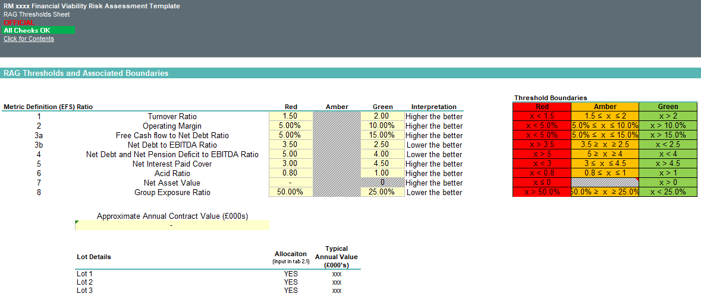
The FVRA - Financial Metrics
The FVRA uses defined financial metrics with clearly communicated thresholds

Slide 30

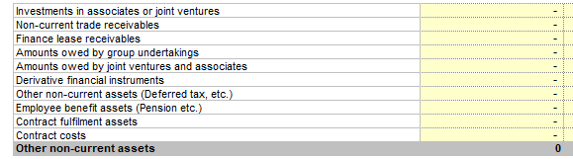
The FVRA - Financial Input
The FVRA collects detailed financial information for use in analysis.
For best result make sure to use the most recent/relevant information
Input is not restricted to statutory financial statements - the more information provided the deeper the understanding of the financial profile
A clear breakdown of key figures such as liabilities can prevent delays to assessing

Slide 31
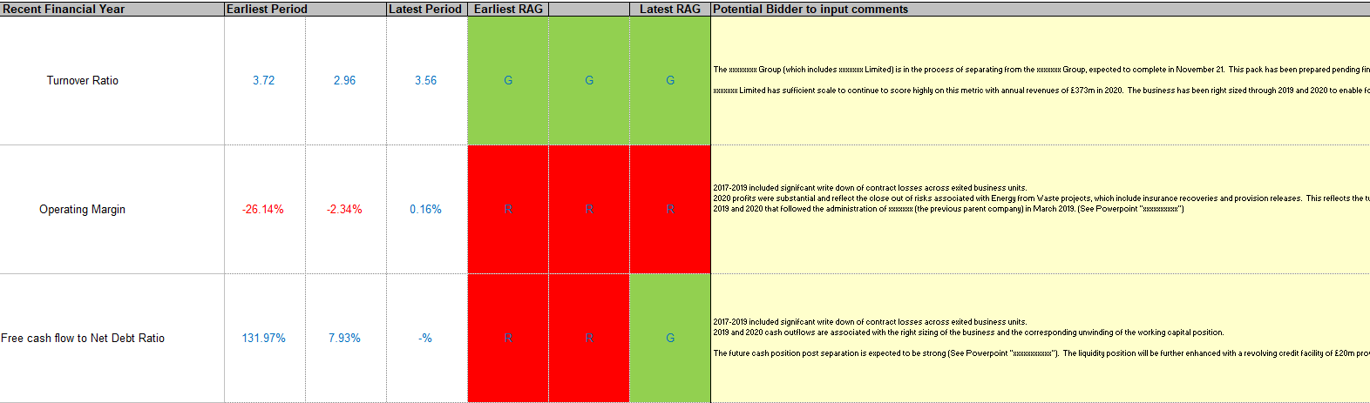
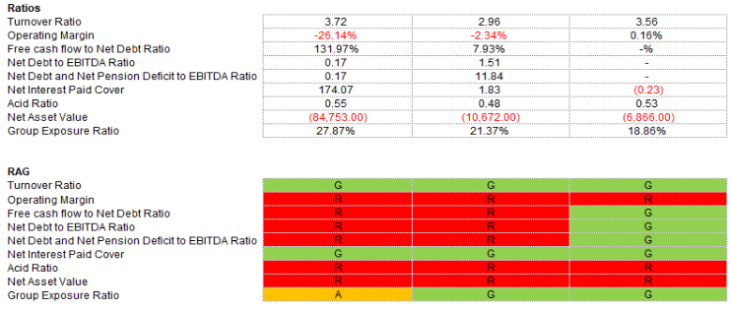
The FVRA - Mitigating Commentary
Commentary can be provided to to ensure a deeper understanding of the financials
The key areas/ratios in the FVRA, a RAG status/risk classification is assigned:
Red - Higher Risk
Amber - Medium Risk
Green - Lower Risk
Bidders should set out explanations and provide relevant mitigations on the relevant tabs in the FVRA tool.
A Red/Amber rating does not mean an automatic fail. It does however increase the risk perception, suitable mitigating commentary will help GCA understand your business better.

Slide 32

FVRA Outcome
The FVRA has 3 possible outcomes
Acceptable
  EFS considered an acceptable level
Acceptable with mitigating actions
  Some concerns regarding EFS, mitigation is required, e.g Guarantor
Unacceptable
  EFS risk considered to high

Slide 33
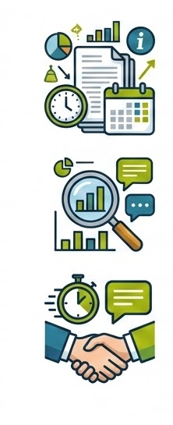
Key Takeaways
Consider what information you are submitting - use the most recent/relevant information, this doesn't just have to be statutory financial statements
Review the output of the metrics, use the commentary to provide a full explanation for any metrics that are not green. Additional information can also be submitted
Provide a timely and comprehensive response if further information is requested

Slide 34
Here for you
info@gca.gov.uk
0345 410 2222
www.gca.gov.uk

